Slide 1
Generalization of a routing map
Kirill “Zkir” Bondarenko SotM Baltic, 2013

Slide 2
Routing between streets

Slide 3
Routing between countries
OSRM:

Slide 4
What we need on PNA
Limited set of roads
Simplified geometry
Why:
Mobile devices (PNA), even today, have much more weak hardware than OSRM server.

Slide 5
Classification by road significance
For Russia, it’s just possible to select roads by highway tag (trunk, primary a secondary)
2000+ km by trunks only

Slide 6
Road classification in European countries?
highway = trunk in Poland

Slide 7
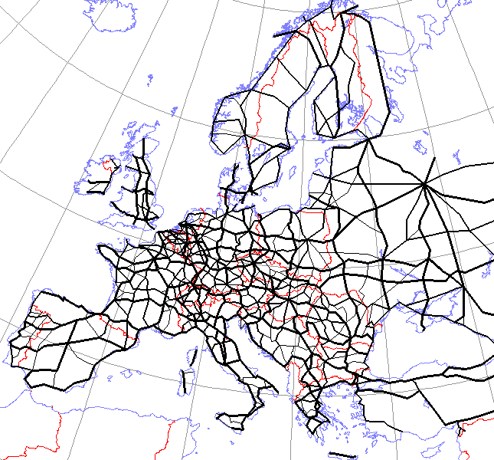
European Routes Exx
Ref = E xx
Int_ref=E xx
Relation
network=e-road
Hand-drawn schema from Wikipedia

Slide 8
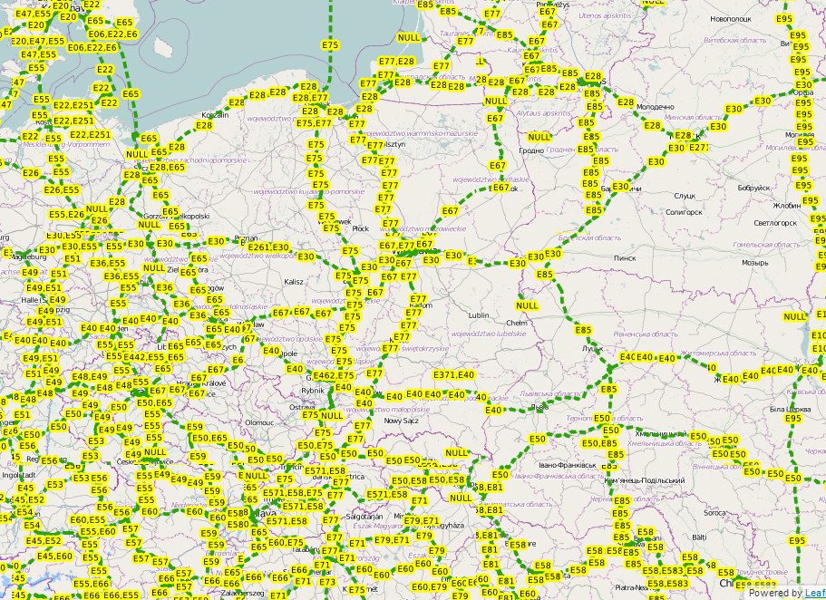

Slide 9
European Routes Exx

Slide 10
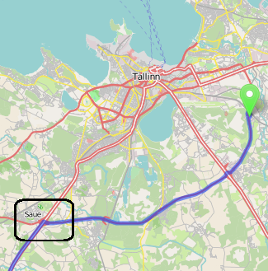
Still too much details

Slide 11
Before and after

Slide 12
Still routable!

Slide 13
This algorithm has been developed by Russian community
Authors:
OverQuantum
FreeExec (java port)
Two Implementations:
VB6
Java
Source code available on Github

Slide 14
Problems: “islands” and “missing edges”

Slide 17
Conclusions
We can select linked subset of roads
There are still some problems with connectivity
We have developed algorithm of routing graph simplification
Junctions are transformed to nodes
Two carriageway roads are converted to one carriageway roads
This algorithm allows us to produce lightweight routable overview maps

