Slide 1
OSM and CityGuide. Quality Assurance for Navigation Software
Kirill “Zkir” Bondarenko SotM Baltic, 2013

Slide 2
CityGuide (1)
Navigation software
Rendering
Routing
Address search
Many other features ☺

Slide 3
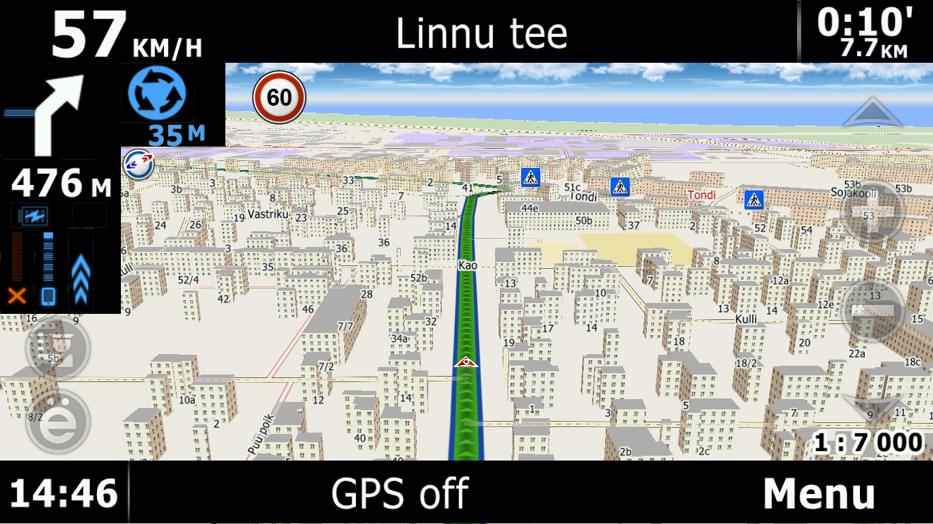
CityGuide (2)

Slide 4
CityGuide
Own file format *.cgmap
One *.cgmap file is usually region of a country
Osm→cgmap: regular updates for Russia and some other countries
→

Slide 5
Free data vs users’ needs
What Openstreetmap data is known for |  | What users need
Many editors Anybody can edit |  | Users do NOT want to edit maps themselves
Prone to vandalism |  | Quality
Changes can be unpredictable |  | Stability

Slide 6
Test before release!
Automated tests
The map (*.cgmap) is released only if it passes release criteria:
Routing graph
Address search
Minor consistency (e.g. shoreline is not broken)

Slide 7
http://peirce.zkir.ru

Slide 8
http://peirce.zkir.ru

Slide 11
Test: road graph connectivity
Basic idea:
The road graph should be connected.
Roads should be connected by common nodes.
There should NOT be isolated fragments (also known as ‘islands’)
Also:
If we select roads by level, e.g. only hw=trunk and hw=primary, this road graph should also be connected.

Slide 12
Isolated sub-graphs aka ‘islands’

Slide 13
Even wrong statuses!

Slide 14
Test: Major highway dead ends
Basic idea:
Important road cannot just end with dead-end in the countryside.
It should lead somewhere!

Slide 15
Missing road fragments

Slide 16
Missing road fragments

Slide 17
Test: Address registry
Address registry is not corrupted
Every street and building is related to a settlement
Addr:street tag matches name tag of the street way

Slide 18
Conclusion
CityGuide users receive maps, which have passed Quality Assurance
→QA →
*.cgmap
*.osm
http://peirce.zkir.ru

