Slide 1
Micromapping
Marek Strassenburg-Kleciak
aka
Marek Kleciak

Slide 2
Micromapping?
Micromapping or micro-mapping in OpenStreetMap (OSM) refers to the mapping of small scale features. This may include mapping such objects as a building entrance, as well as the footway and steps leading to that entrance. Another aspect is to improving the visual representation of a scenery (here: usually a very limited city area) for 3D for example. Therefore this includes improving geometries (buildings, landuse, ...) but also to add very small objects as city furnitures (streetlamps, benchs, ...) and village green (trees, hedges, ...) Most mapping in OSM is not concerned with such fine detail, but rather with larger scale objects such as roads. Some advantages of micromapping are to enable advanced and detailed routing, especially routing for the mobility and vision impaired.

Slide 3
Idea

Slide 4
Why?
„Wikipedia effect“
Exactness
Active user
Time

Slide 5
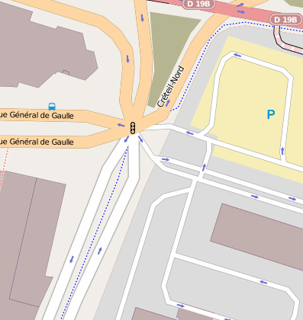
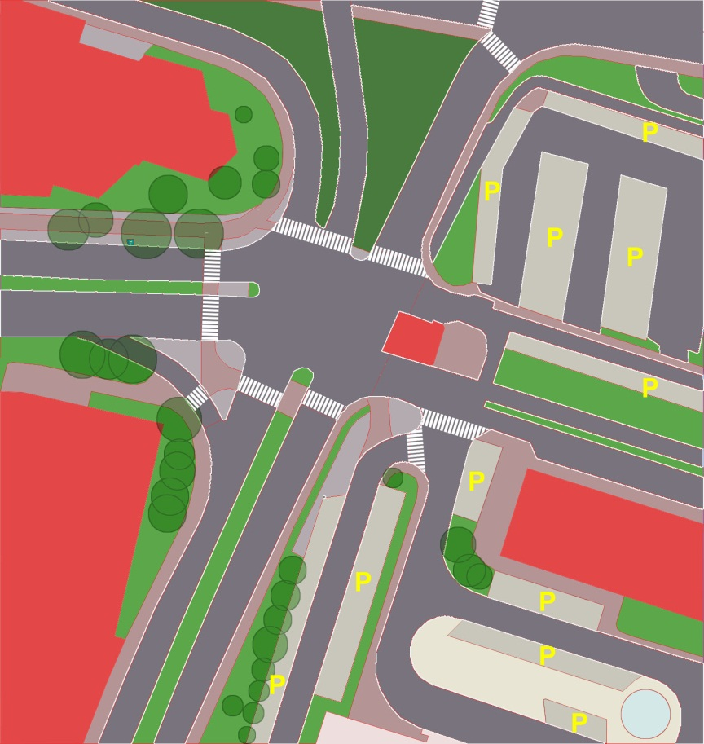
Why?
Fun
More content = more use cases

Slide 6
Problems
No exactly definition
No good rendering for more content
No „full CAD“ tools
Significantly more data
No layer concept recently and …
OSM „traditionalists“

Slide 7
This is NOT micromapping

Slide 8
Not exactly enough (orthogonal)

Slide 9
Lack of details, accuracy

Slide 10
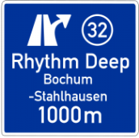
Technical possibilities for advanced navigation systems
Better street recognition
Exactly positioning (lane navigation)
More safety in traffic
Automatized object recognition systems for OSM technically possible. (Data collection with decimeter accuracy)

Slide 11
Thank You & especially !

