Slide 1
OSM Full 3DB definition
Marek Strassenburg-Kleciak
aka
Marek Kleciak

Slide 2
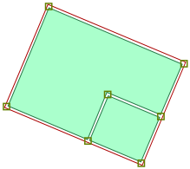
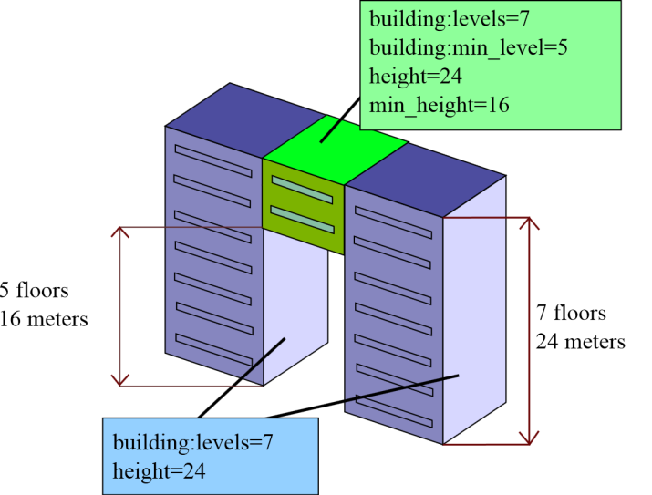
Simple 3D buildings (S3DB)
Definition: http://wiki.openstreetmap.org/wiki/Simple_3D_buildings
Generalization approach:
Building parts
Heights for building parts
Simple roof library
Target: „normal“ mapper.
Easily generation of data coverage
Image
roof:shape | flat | gabled | half-hipped | hipped | pyramidal | gambrel | mansard | dome | round

Slide 3
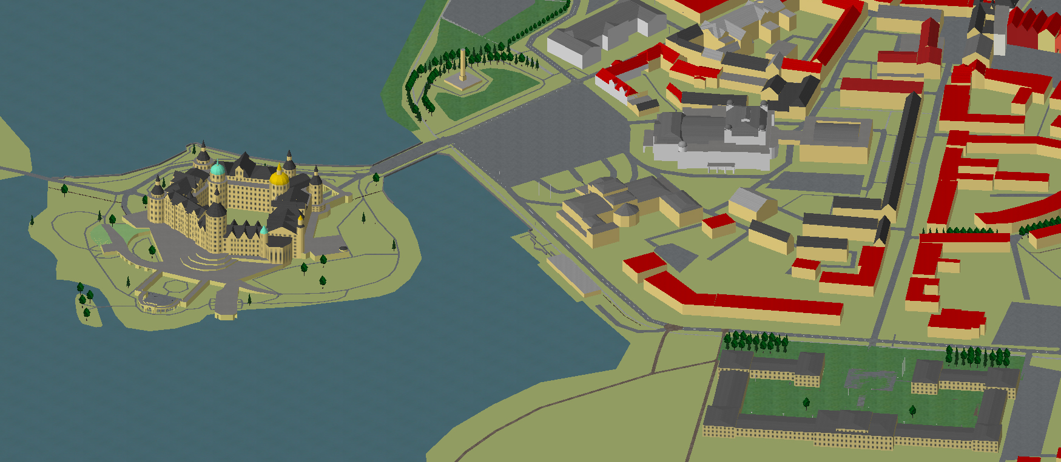
Avaiable results
+ easily to understanding and implementation, small database
limited modelling possibilities, no indoor mapping compatibility,
not interesting for proffessional 3D freaks because of detail limitation

Slide 4
„Full“ approach: 3D maps for more communities, e.g.:
OSM 2D
full 3D models
Blender
Geocoaching

Slide 5
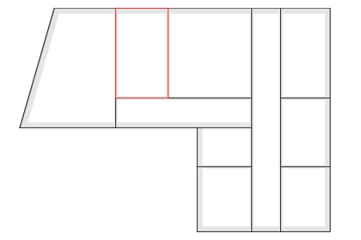
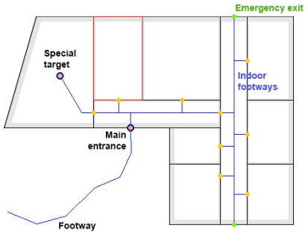
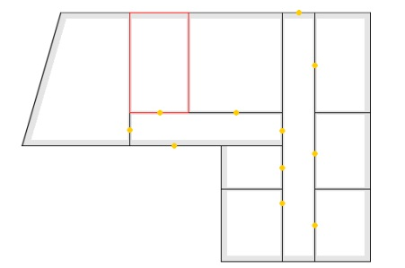
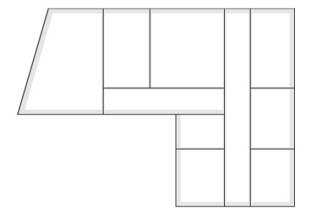
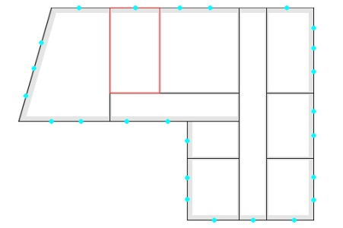
„Full“ approach: more details & indoor structures possible
building=yes
room=* (via relation)
name=*
Rooms as relation with name
wall=yes
height=*
width=*
Level=*
door=yes
height=*
width=*
type=*
wall=indoor
height=*
width=*
Level=*
window=yes
height=*
width=*
type=*

Slide 6
3D Elements
Wall
Opening
Slab
Tube (Surface generated by a polyline sweeping along a space curve)
Stairs
Column
Slab
Roof
Parametric objects
Parametric objects with time conditions

Slide 7
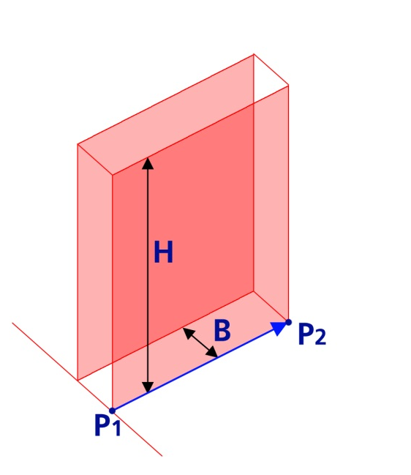
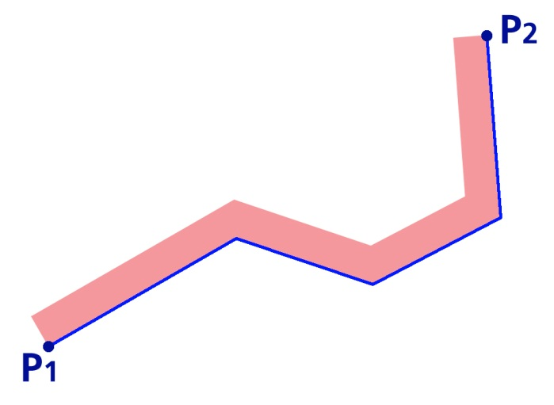
Basic 3D elements
1. Wall basic tagging
barrier=wall
Polyline defined by coordinates on n elements ( Typical OSM 2D view)
P1 (x1, y1, z1),
P2 (x2, y2, z2),
… Pn
Width B, width=*
Height H, height=*
Height over terrain, min height =*
Surfaces: surface=* the same for all sides: - Front surface:front - Back surface:back - Top surface:top - Bottom surface:bottom
Details see: http://wiki.openstreetmap.org/wiki/DE:Wall

Slide 8
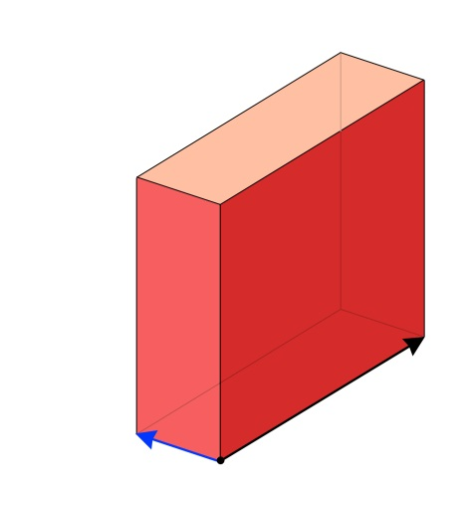
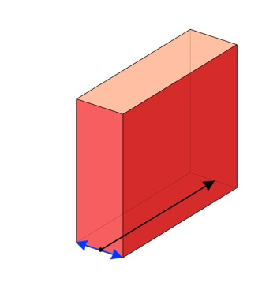
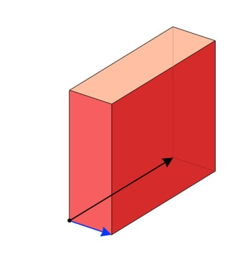
Basic 3D elements
1. Wall basic tagging
Width direction
, width:left = <value> | width:middle = <value> | width:right= <value>

Slide 9
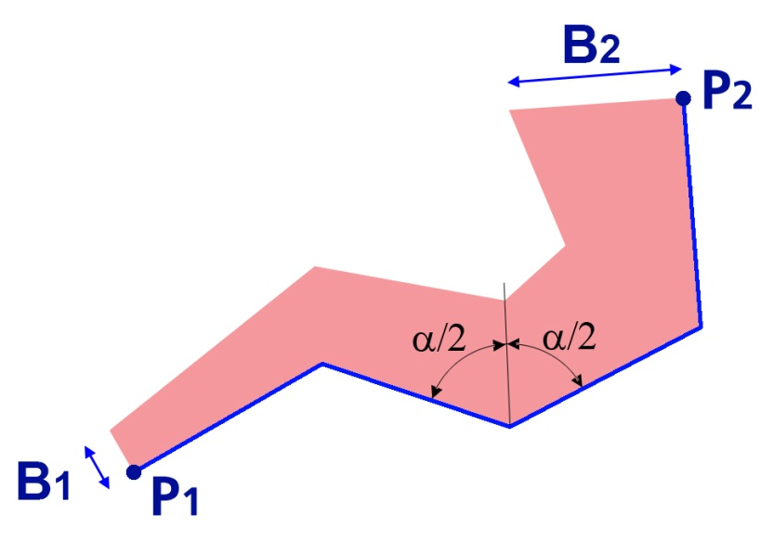
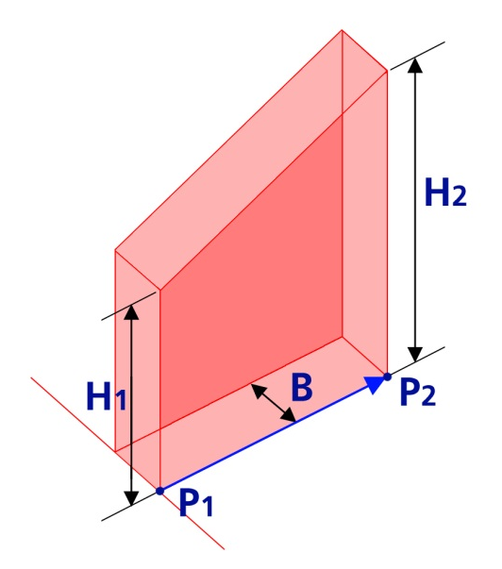
Basic 3D elements
1. Wall basic tagging
Different values of start- und end parameter
Different widths:
B₁, width:start:left =<value>
B₂, width:end:left =<value>
Different heights:
H₁, height:start =<value>
H₂, height:end =<value>

Slide 10
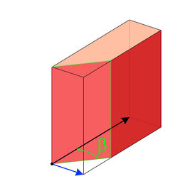
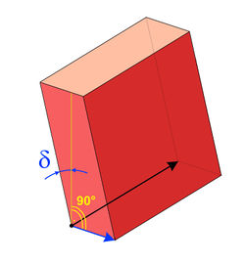
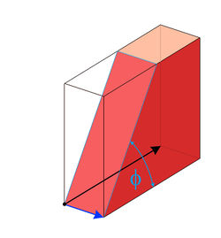
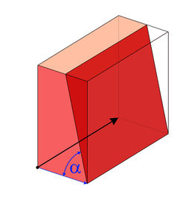
Basic 3D elements
1. Wall advanced tagging. Cutting.
Wall_start_vertical_angle: <Value> | Wall_inclination_angle: <Value> | Wall_start_horizontal_angle: <Value> | Wall_width_angle: <Value>
Cutted start and/or end | Wall inclination | Cutted in drawing direction start or end | One or 2 sides cutted

Slide 11
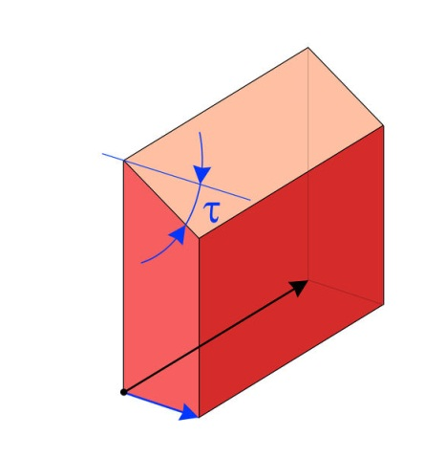
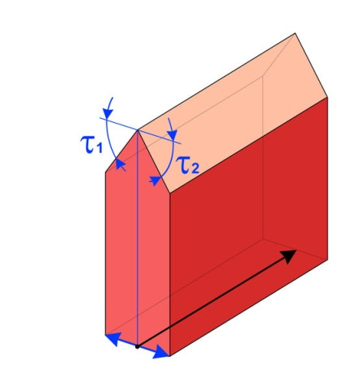
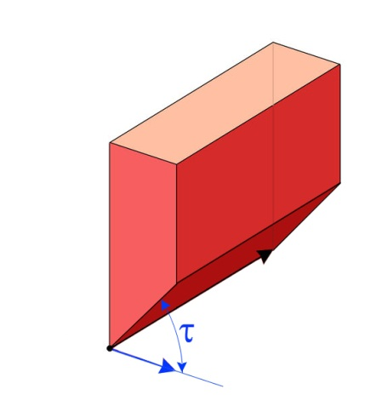
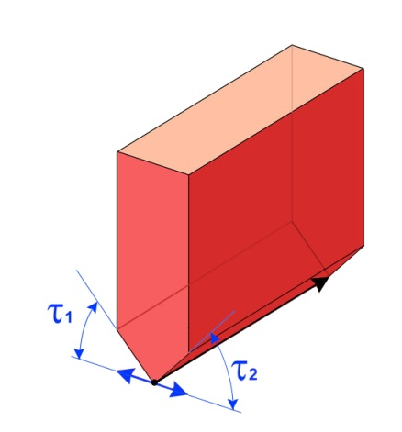
Basic 3D elements
1. Wall advanced tagging. Top / down
Wall_top_horizontal_angle: <Value> | Wall_top_horizonatal_double_angle: <Value> | Wall_down_horizontal_angle: <Value> | Wall_down_horizonatal_double_angle: <Value>
One sided cutting of wall on top | Double sided cutting of wall on top | One sided cutting of wall down | Double sided cutting of wall down

Slide 12
Basic 3D elements
1. Wall as area
barrier=wall area=yes
Polyline defined by closed polyline coordinates with n elements (typical OSM 2D view)
P1 (x1, y1), P2 (x2, y2),…. Pn (xn, yn),
height =*
height_min =*
Material: surface =* or: - Top side surface:top - Bottom side surface:bottom

Slide 13
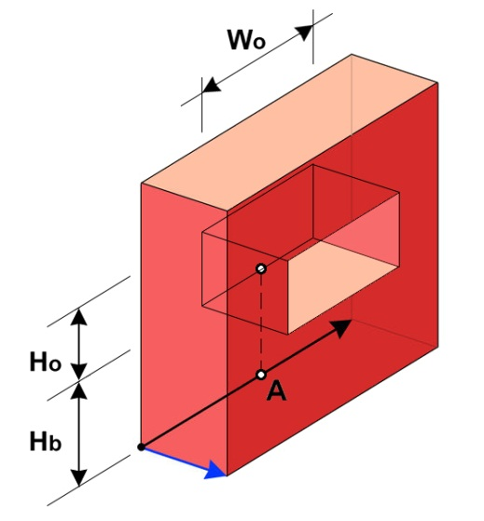
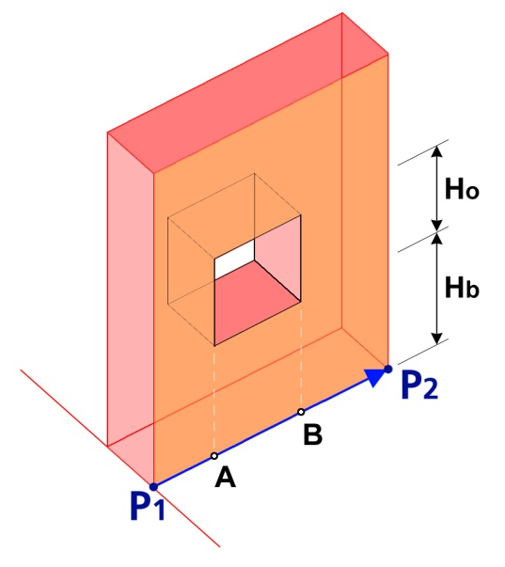
Basic 3D elements
2. Openings
opening=<yes, door, window, niche>
Definition as a point or points (typical OSM 2D view)
Insertion point A on the „wall“ line.
A (x1, y1), opening:yes
Width opening Wo, width= <value>
Height opening Ho, heigth= <value>
Height start of the opening Hb heigth:parapet= <value>
Start and end point A on the „wall“ line.
A (x1, y1), opening:start= yes
B (x2, y2, ), opening:end= yes
Height opening Ho, heigth= <value>
Height start of the opening Hb heigth:parapet= <value>
In this case are can the value of Ho and Hb for points A and B be different.

Slide 14
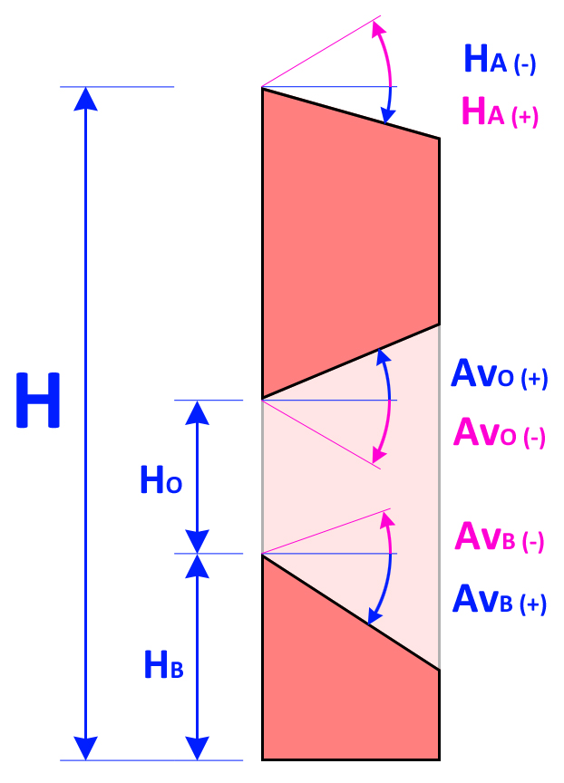
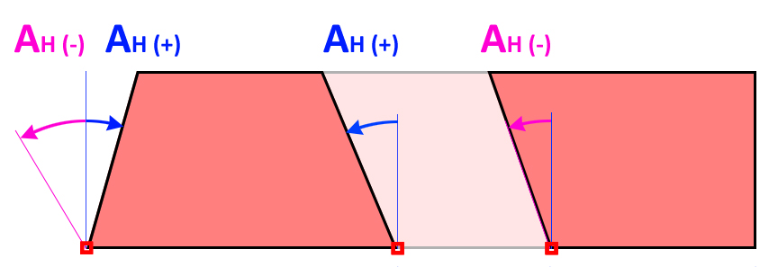
Basic 3D elements
2. Openings advanced tagging.
Wall_top_horizontal_angle: <Value> | Wall_top_horizonatal_double_angle: <Value> | Wall_down_horizontal_angle: <Value> | Wall_down_horizonatal_double_angle: <Value>

Slide 15
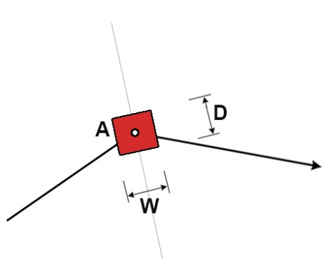
Previev columns
6. Column=yes. Basic tagging
Point with:
width=*
depth=*
height=*
type= rectangular
surface=*
Point with:
width=*
depth=*
height=*
type= adjusted
surface=*
Point with:
width=*
depth=width
height=*
type= circle
surface=*

Slide 16
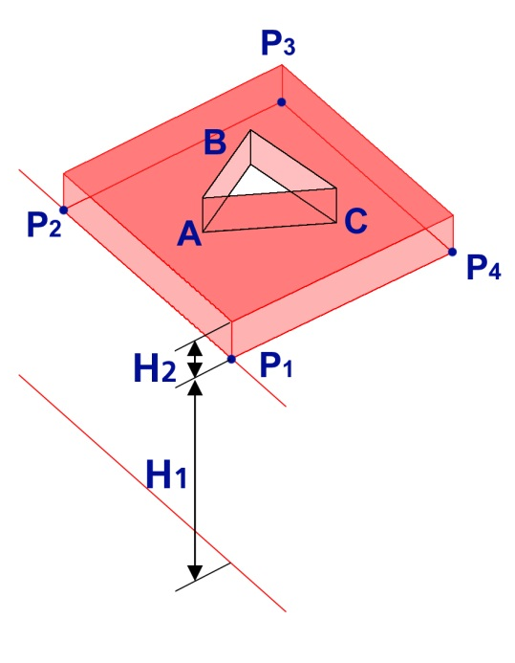
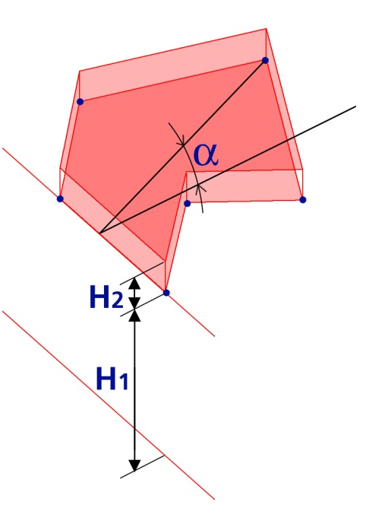
Preview roof and ceiling
7. slab=yes.
Basic tagging: height, surface, height_min
level=*
8. roof=yes.
Basic tagging: height, surface, height_min, angle=*, level=*

Slide 17
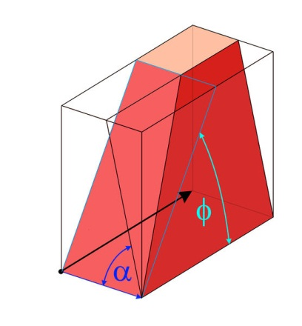
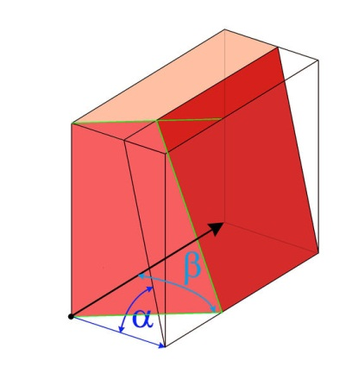
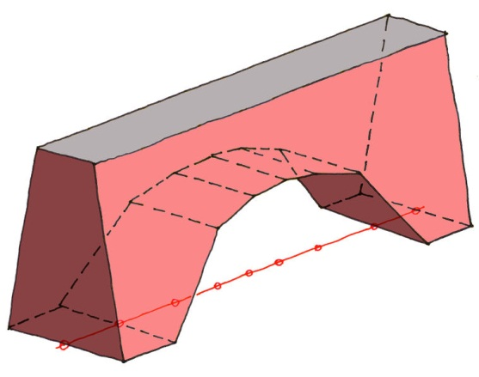
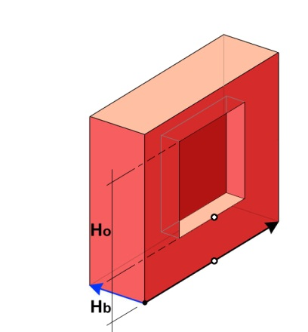
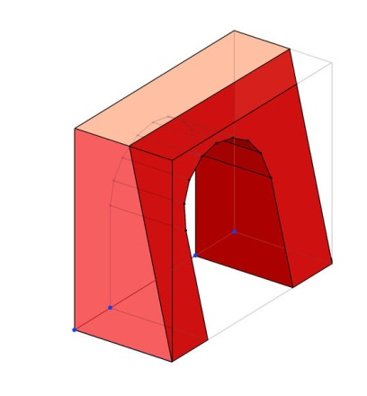
Examples for 2D line with attributes

Slide 18
Possible results
Object modelled by use of elements described in full 3DB approach

Slide 19
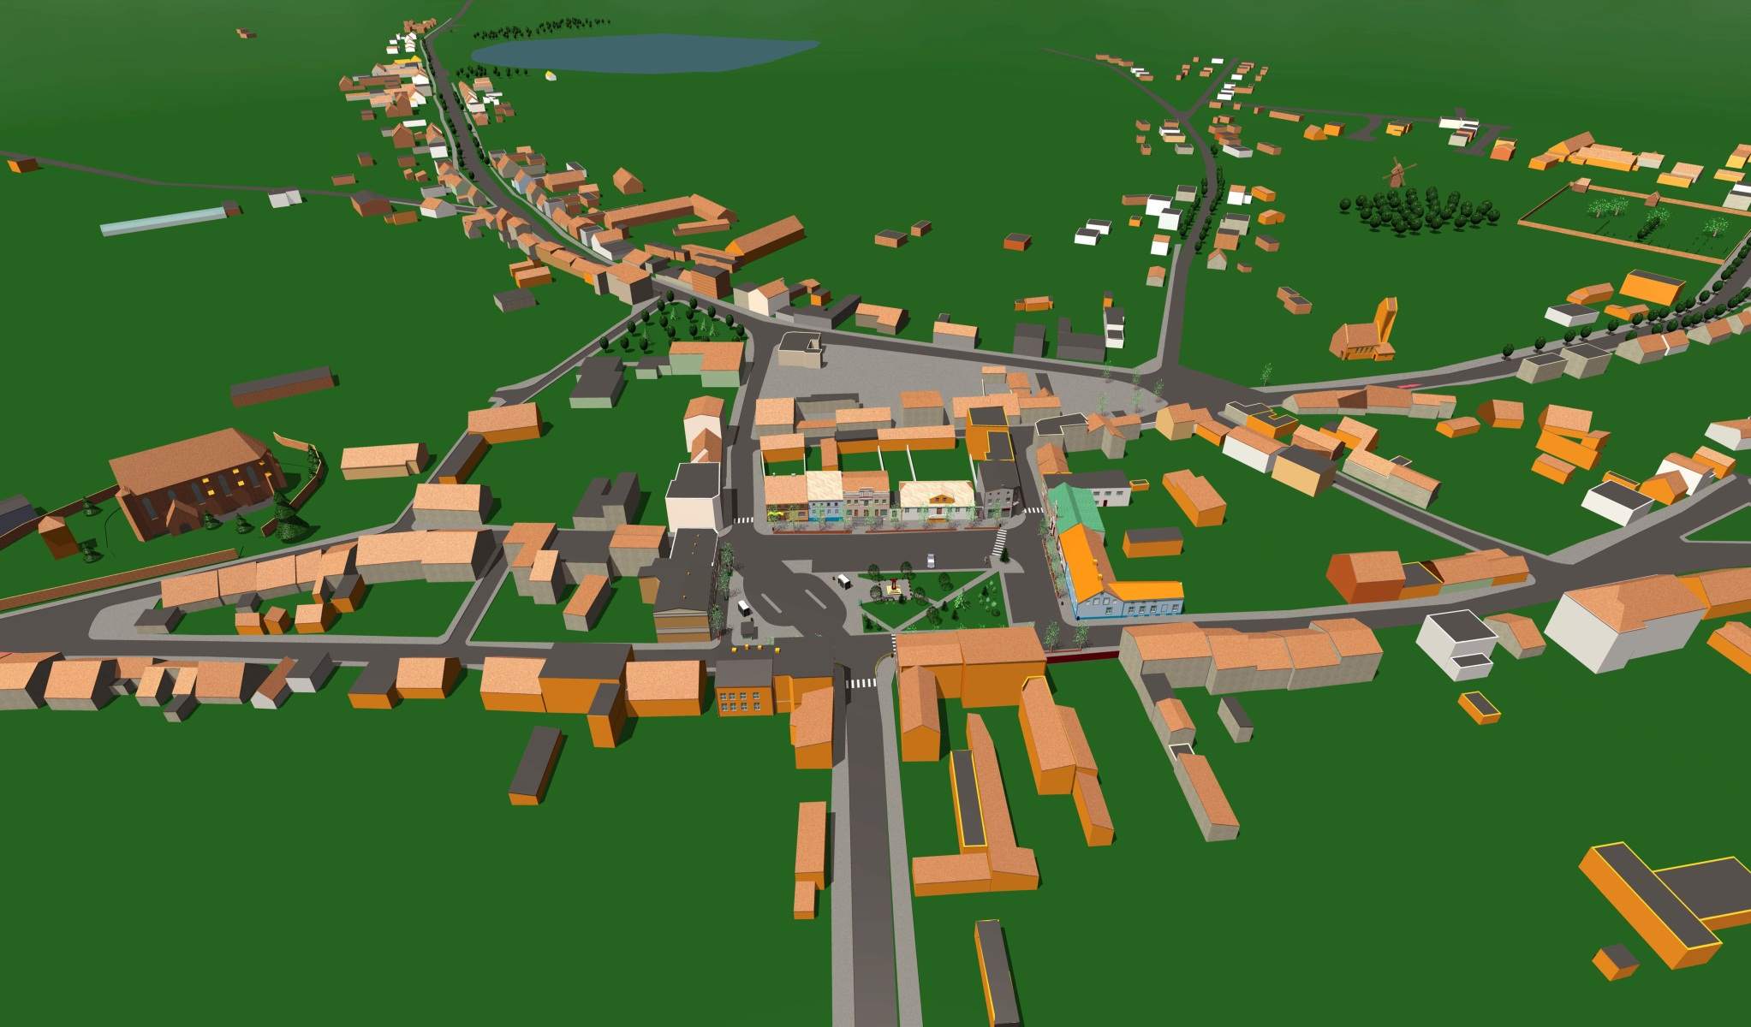
3D example: Krzywin Poland. 1998. Age: 14 y.o. 15 participants, 2 weeks, summer vacation & fun

Slide 20
Benefits Cooperation with cities
Backward compatibility because of 2D known OSM elements tagging with additional parameters
Full 3D modelling of whole aerth possible: buildings with indoor structure, streets, bridges etc.
Industry Foundation Classes compatible = easily import of 3d objects from
AutoCAD,
ArchiCAD,
Allplan and ca. 20 other CAD programs

Slide 21
Thank You &, especially !

