Slide 1
OpenStreetMap in Finland
Pekka Sarkola
SOTM Baltics, 3.-4.8.2013

Slide 2
Agenda
Some other irrelevant issues about Finland
Open Data in Finland
Use of OpenStreetMap in Finland

Slide 3
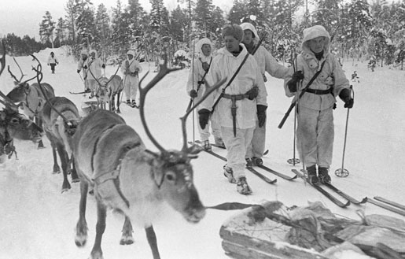
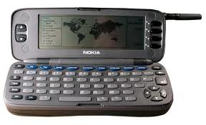
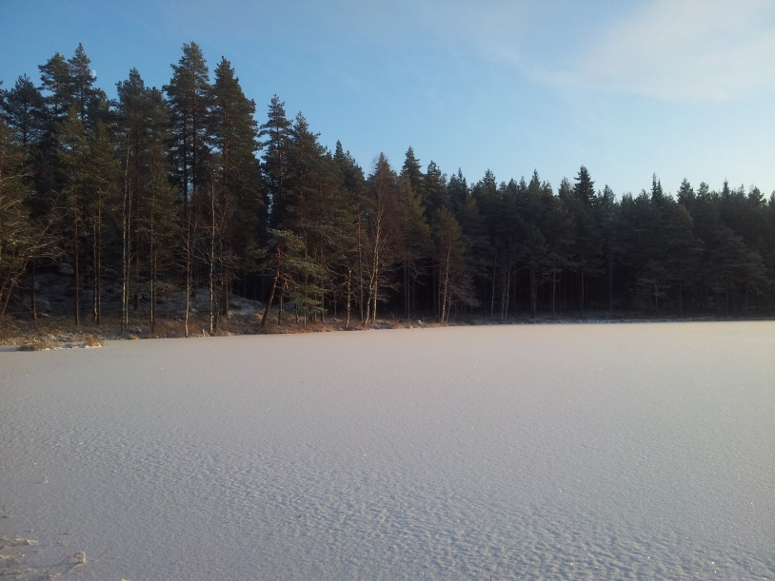
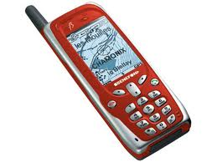
Finland

Slide 4
Finnish
10 Hardest Languages To Learn For English Speakers
1. Basque
2. Arabic
3. Cantonese
4. Finnish
5. Hungarian
6. Navajo
7. Mandarin Chinese
8. Japanese
9. Estonian
10. Polish
Epäjärjestelmällistyttämättömyydelläänsäkäänköhän
not even with his/her ability to not to make a thing unsystematic

Slide 5
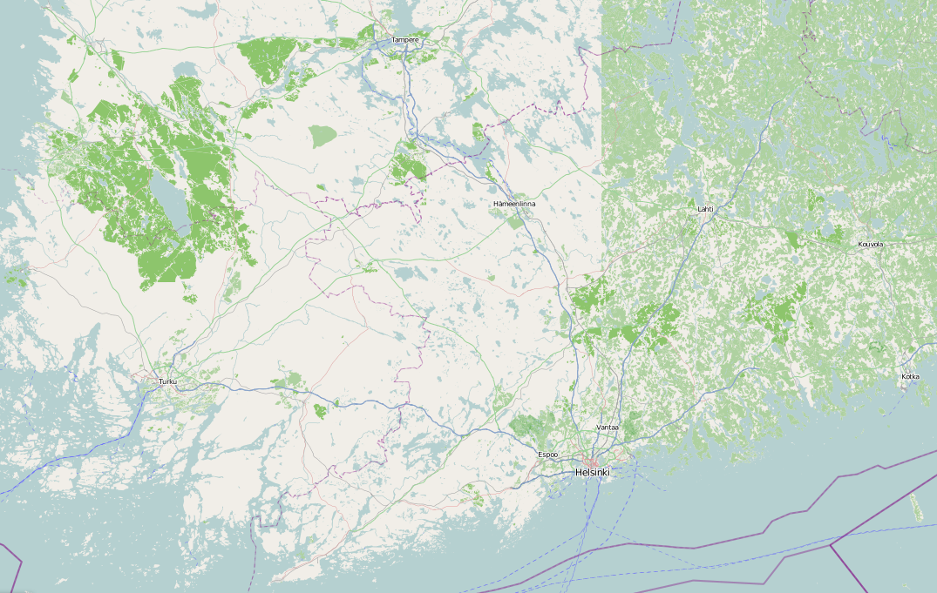
Forests of Finland

Slide 6
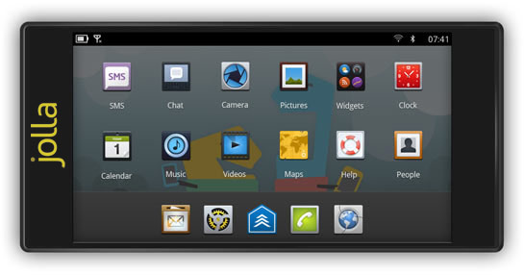
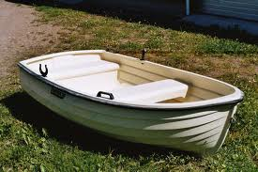
Mobile phones

Slide 7
Open (geo)Data of Finland
National Land Survey of Finland
Open the game on 2nd of May, 2012
All topographic datasets, no cadastral information
Other agencies will follow
Finnish Meteorological Institute – weather
Statistics Finland – population
Some are waiting
Population Register Centre
municipalities

Slide 8
NLSF - All topographical information
Laser scanning data
Benchmarks
Elevation model 2 m
Elevation model 10 m
Elevation model 25 m
Elevation model 200 m
Municipal Division in Finland
NLS aerial photographs
NLS orthophotos
The Topographic database
Topographic map raster 1:50 000
Topographic map 1:100 000
Topographic map raster 1:100 000
Topographic map 1:250 000
Topographic map raster 1:250 000
Topographic map raster 1:500 000
Place names
Basic map raster 1:20 000
Background map series
Road names raster
General map 1:1 000 000
General map raster 1:1 000 000
General map 1:4 500 000
General map raster 1:4 500 000
Free to import to be part of OpenStreetMap, right?

Slide 9
Terms of use
Free right of use means that available topographic data products can without charge be:
used within the organisation
published as desired
distributed freely to others
further processed to new products
sold
...or used in any other way
2.2. Duties and responsibilities of the Licensee
…
remove the name of the Licensor from the product or service, if required to do so by the Licensor.
…

Slide 10
NLSF data & OpenStreetMap
Not imported or guide lined
Because no consensus about NLSF’s Terms of Use by Finnish OSM community
Is imported / used by invidual OSMers
No attributions
No source tagging

Slide 11
Use of OpenStreetMap in Finland
Helsingin Sanomat
the biggest daily subscription-based newspaper in Scandinavia
Part of their Data Journalism activities
BlindSquare
AudioAugmentedRealityMap

Slide 12
HS – trafic information

Slide 13
HS – Best municipality

Slide 14
BlindSquare

Slide 15
BlindSquare

Slide 16
BlindSquare
OpenStreetMap is great, but…
Coverage
Entrances of buildings
Traffic lights
Facts
Idea: Jan-2012
Release in AppStore: May-2012
3 weeks & 30 countries
6 months & 50 countries

Slide 17
Kiitos!
posiki
paikkatieto.com
Pekka.Sarkola@gispo.fi

