Slide 1
OSM in Poland
Marek Strassenburg-Kleciak
aka
Marek Kleciak

Slide 2
Some statistics

Slide 3
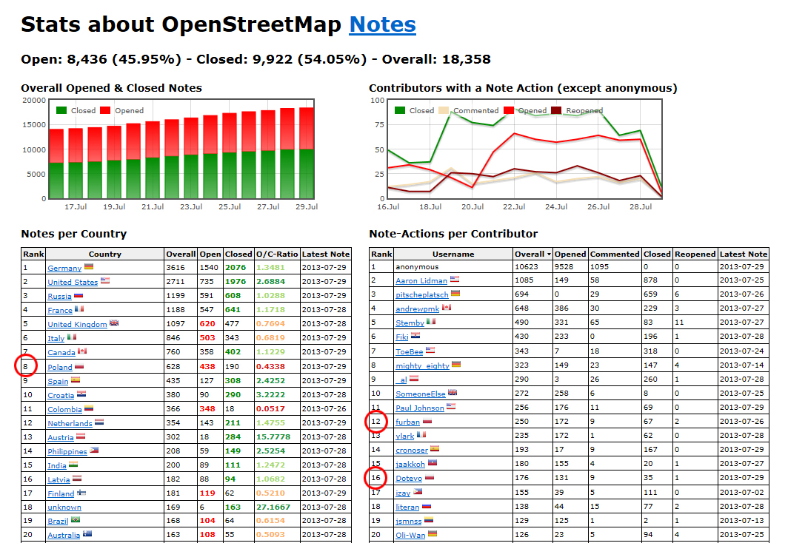
Some statistics

Slide 4
Some statistics
In 6 last months 40% new data
Worldwide from 1,2% to 1,5%
In Europe from 2,3% to 2,8%.
29 mio. nodes,
over 3 mio. ways
ca. 1. mio. relations.

Slide 5
„OSM Polska“registered association
OSM Polska = non profit organization.
Target: Being visible and contactable in Poland & coordination of OSM promotion
Website: http://openstreetmap.org.pl/osm/stowarzyszenie/
Stowarzyszenie OpenStreetMap Polska Instytut Informatyki Stosowanej Politechniki Łódzkiej ul. Profesora Bohdana Stefanowskiego 18/22 90-924 Łódź
e-mail: zarzad@openstreetmap.pl
REGON: 101078372 KRS: 0000385002 NIP: 7272776770

Slide 6
„OSM Polska“ benefits
Contact with institutions, companies and ministries.
Sponsors
1% tax donation possible
More OSM promotion (TV, web, press, radio) = more:
new users
commercial & free OSM usecases
data donations

Slide 7
Osmapa.pl

Slide 8
Donation:masstracks from medialab.pl

Slide 9
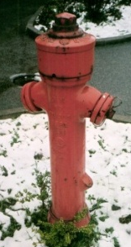
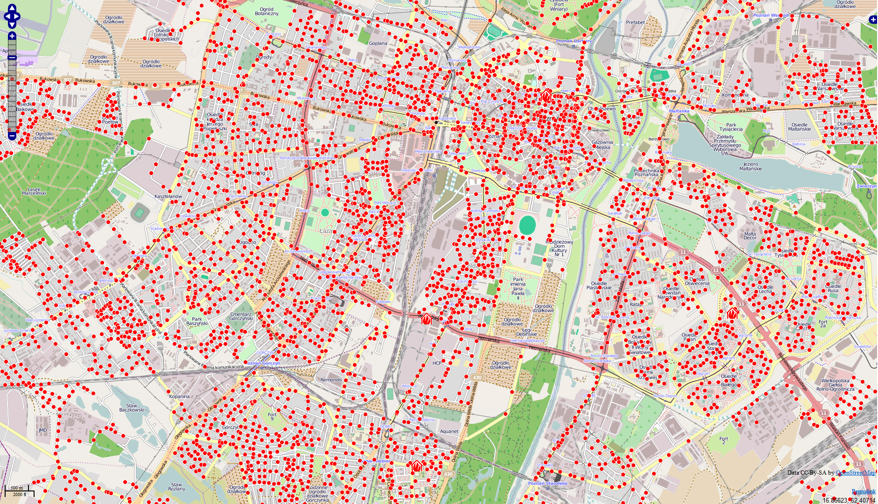
Usecase fire departments Collection of hydrants

Slide 10
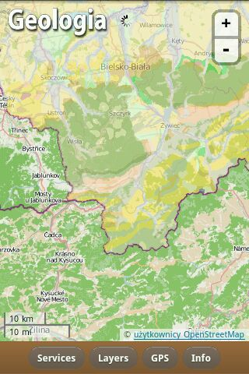
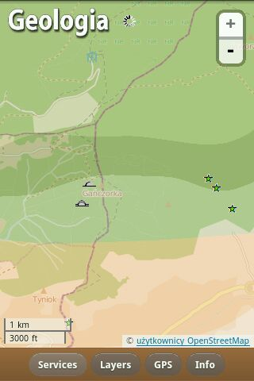
Usecase geology Geoportal Państwowego Instytutu Geologicznego w wersji mobilnej

Slide 11
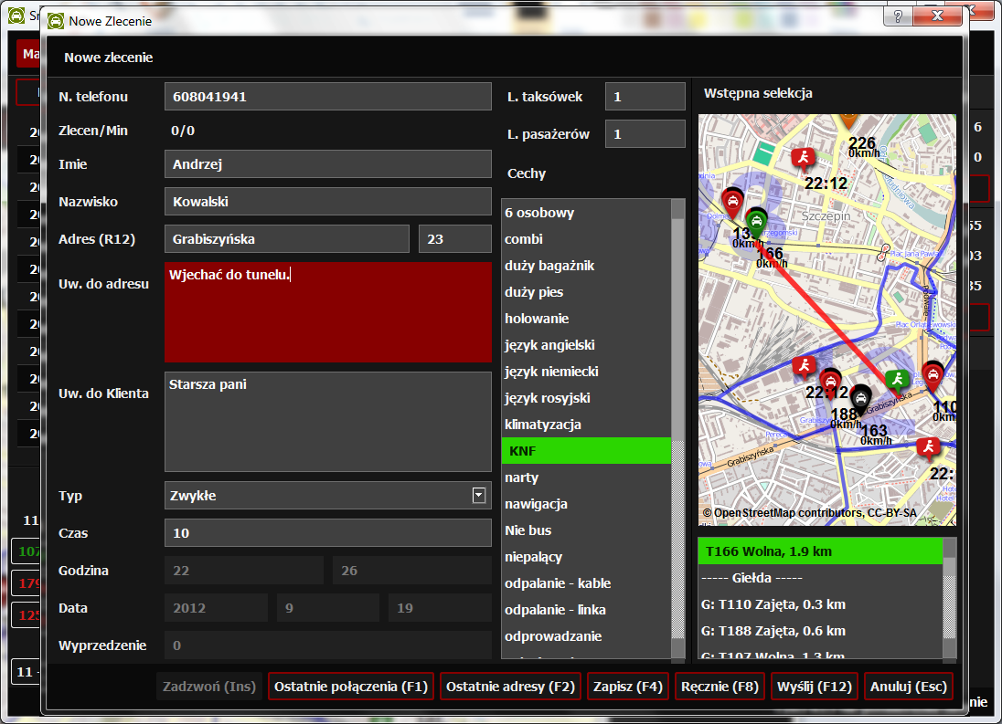
Usecase Taxi Taxi corporations: participation in data collection

Slide 12
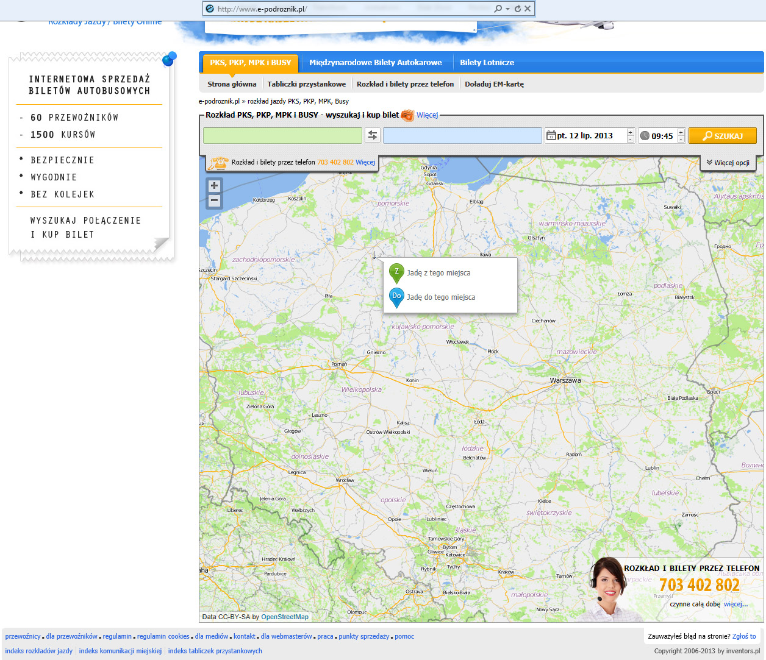
Usecase Tickets

Slide 13
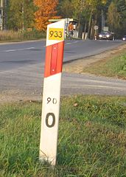
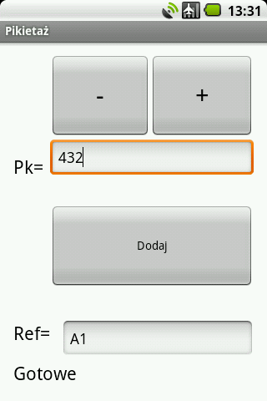
Projects Collection of kilometer markers.

Slide 14
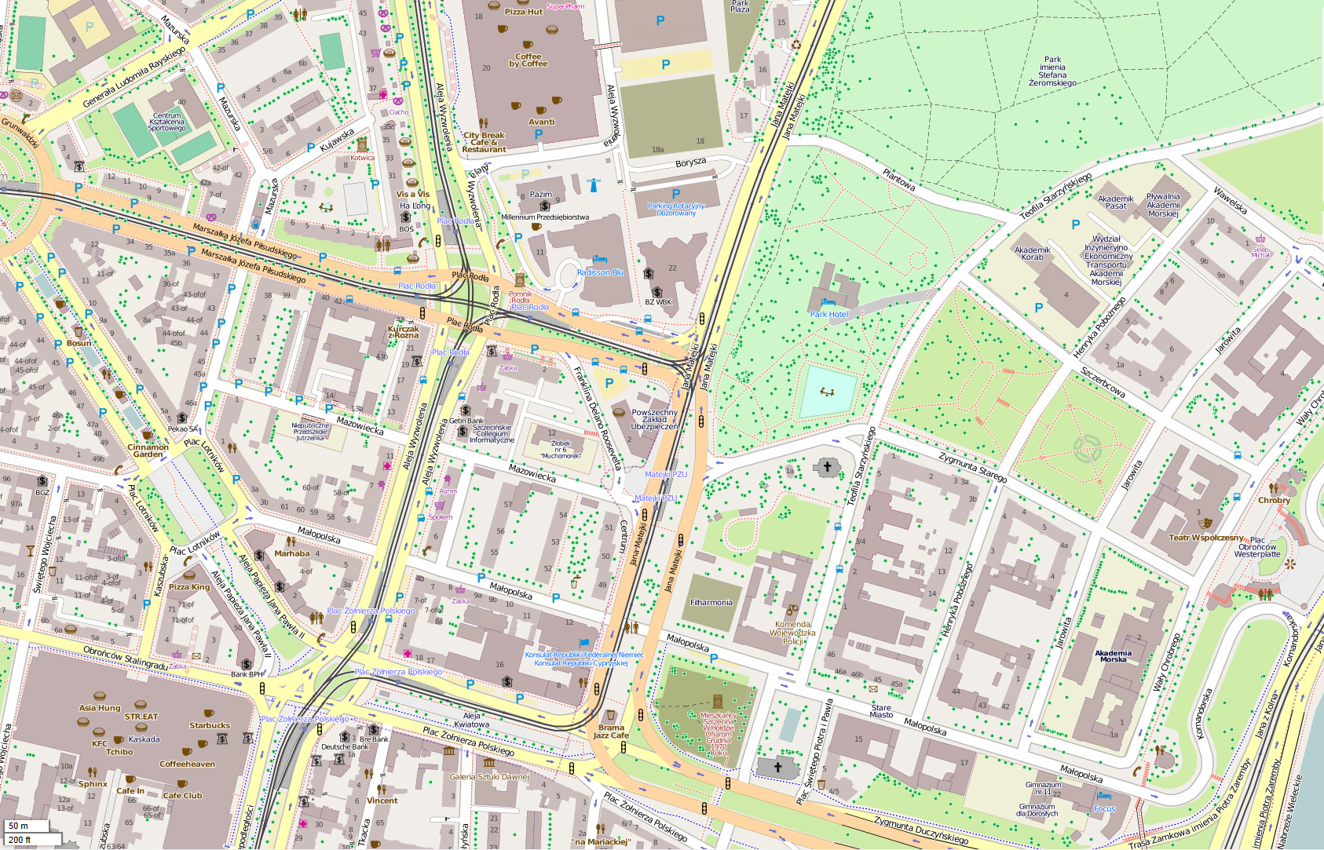
Projects Cooperation with cities

Slide 15
Thank You &, especially !

