Slide 1
OpenStreetMap Estonia
SotM Baltics 2013

Slide 6
Milestones
First edit: 2006 LA2 (Sweden)
Tartu City government import: 2009, January, 50MB
Maaamet WMS permission: 2009, August
All public web services
Base map (Põhikaart), up-to-date aerials. Raster only
Maaamet administrative data – Nov 2009 ~150MB
CORINE import: December 2009 ~150MB
KYSK project: 2010-2011
ADS import: 2012-2013

Slide 7
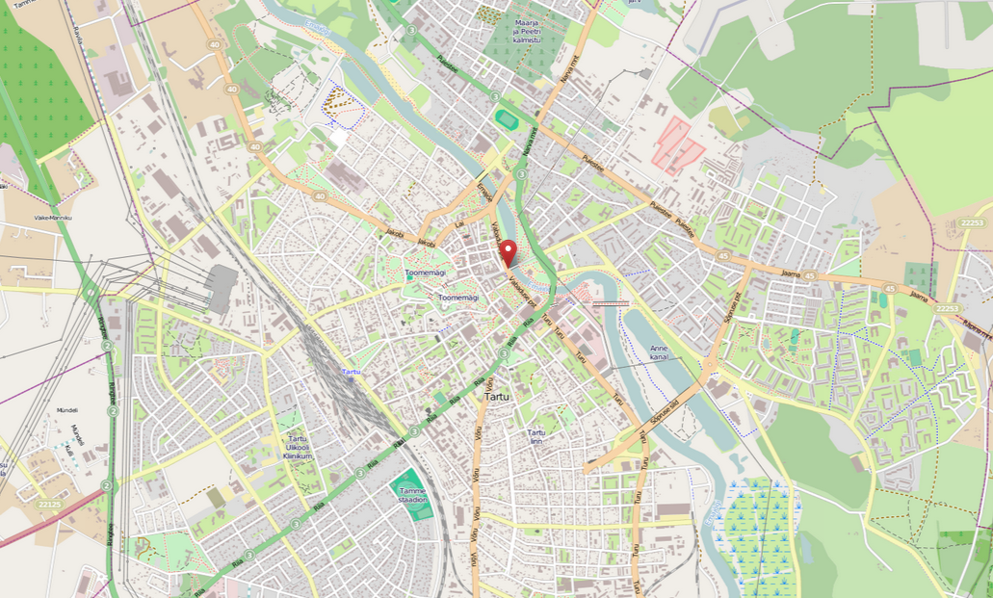
Tartu

Slide 8
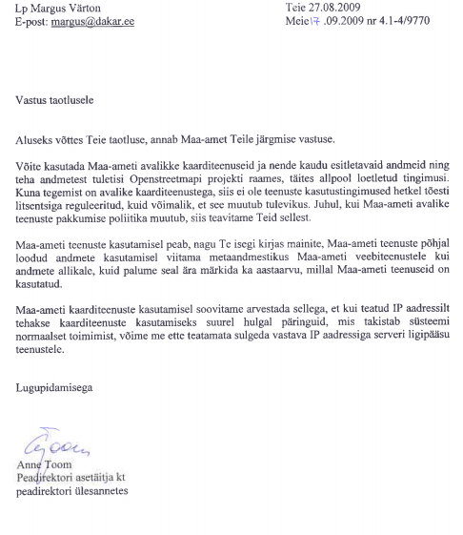
Maaamet official letter

Slide 9
KYSK project 2010-11
Budget: ~30 KEUR (80% spent)
Technical setups
kaart.maakaart.ee purchase
Hosted in Tartu LV
Mapping parties
Paide, Võru, Pärnu
Trainings
Haapsalu, Tallinn Results

Slide 10
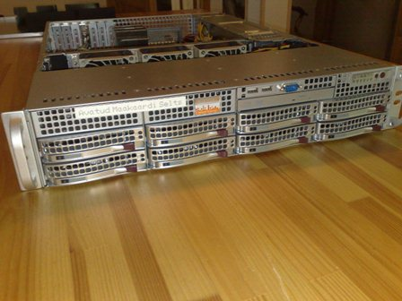
Kaart.maakaart.ee

Slide 11
Haapsalu, spring 2011

Slide 12
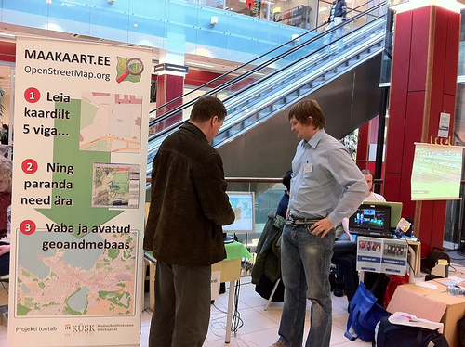
Civil year 2011, Tartu

Slide 13
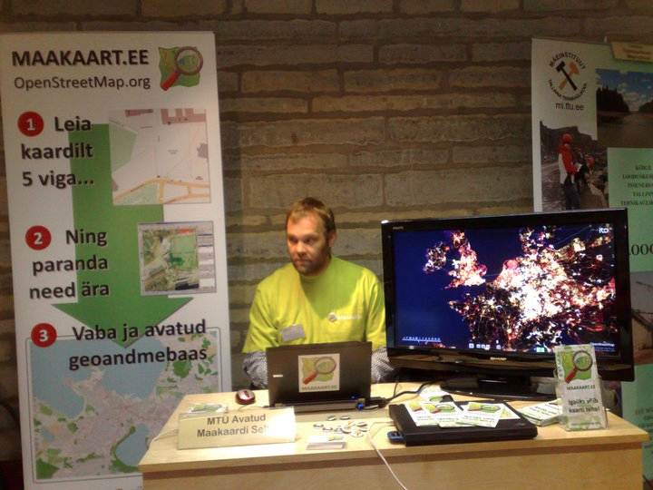
GIS day 2010

Slide 14
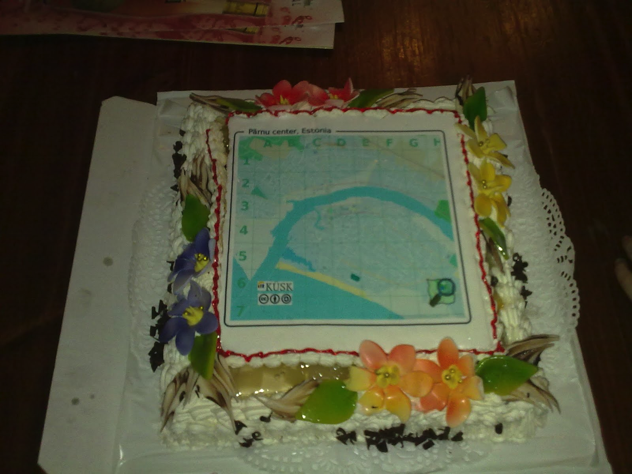
Pärnu mapping party

Slide 15
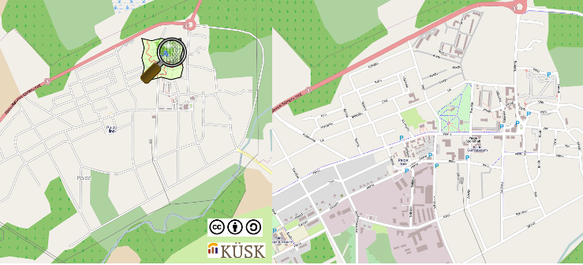
Paide mapping party

Slide 16
Kaart.maakaart.ee
MapServer – global, with Estonian placenames
WMS
Mapproxy cache for tiles and WMS
Imposm weekly planet updates
Geoserver
WFS
Same global database as for MapServer
osm2pgsql (not updated) db with all tags
Other services
Custom Nutiteq 3D building and POI APIs
Routing with graphhopper
Planet.osm bittorrent peer
Other needs
See https://code.google.com/p/maakaart-ee/
Please email jaak@openstreetmap.ee

Slide 17
Corine import
Good sides
Forests
Nice colored map
Bad sides
Fields
Water
Residential areas
General accuracy no good
Too complex data for later editing – relations

Slide 18
Admin data import
Maa-amet official data
Complete vector dataset
Very complex shoreline – 90 % of data
Not always matching with other data
Updates
Maaamet updates twice a year
No change logs provided
Very hard / impossible to update in OSM
Size: about 10% of Estonian OSM data

Slide 19
ADS import
Official Address register – ADS
Open database, set of CSV files in FTP
Need to ask for access
No license restrictions
SviMik tools
Check automatically what is missing
About 36% of Estonian OSM data

Slide 20
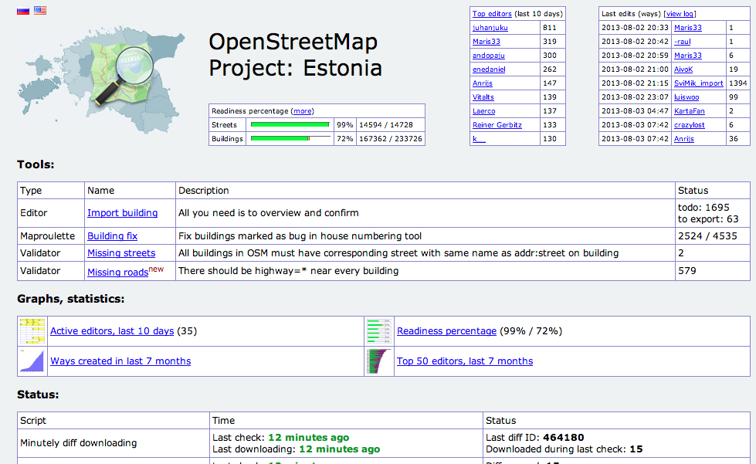
osm.svimik.com

Slide 21
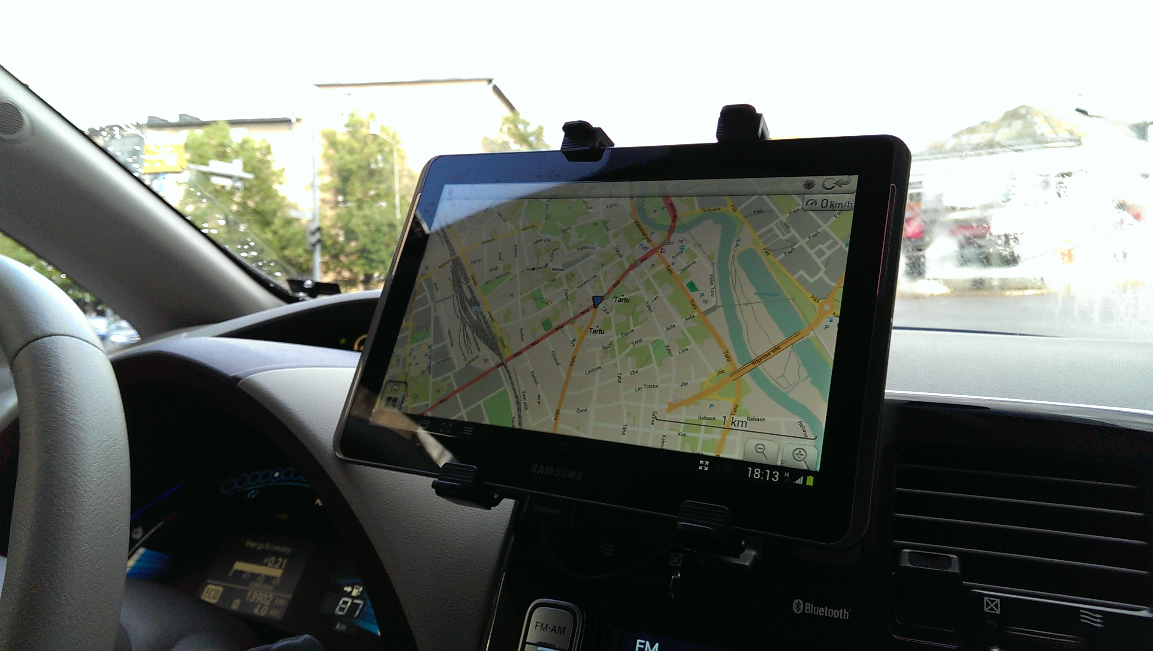

Slide 22
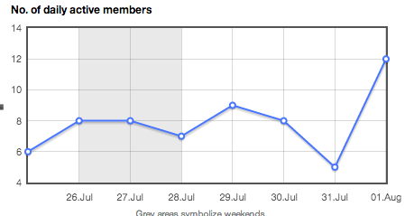
Community
Daily active members

Slide 23
Challenges
Too many imports
Blame me
Active, but small community
Daily updaters < 10
Language division
3 communities: English (German), Estonian, Russian

Slide 24
Thank you
Jaak Laineste
jaak@openstreetmap.ee
MTÜ Avatud Maakaardi Selts
www.maakaart.ee

