Slide 1
University of Tartu
Estonia

Slide 2
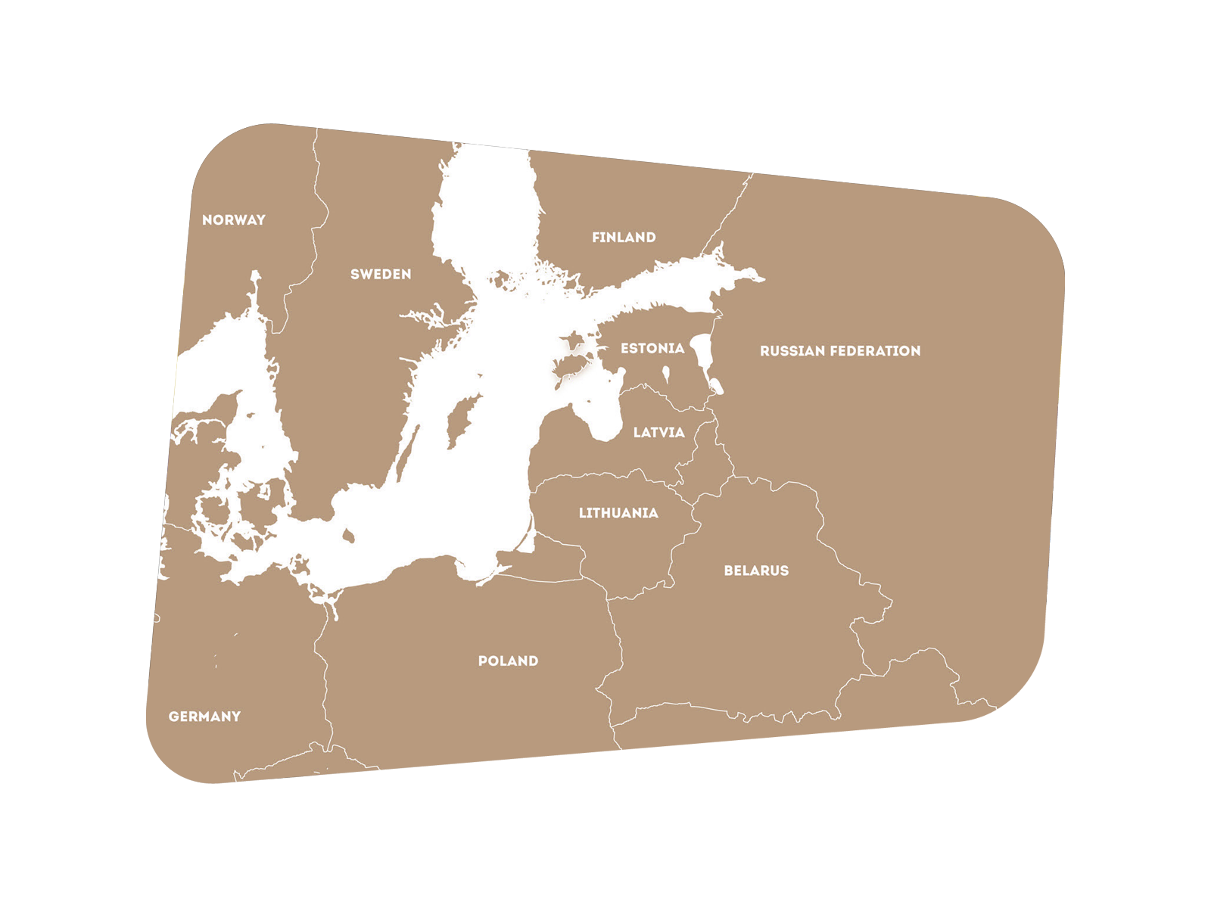
Estonia
EU member since 2004
Schengen Treaty since 2007
Euro as currency since 2011
Notes:
kaart

Slide 3
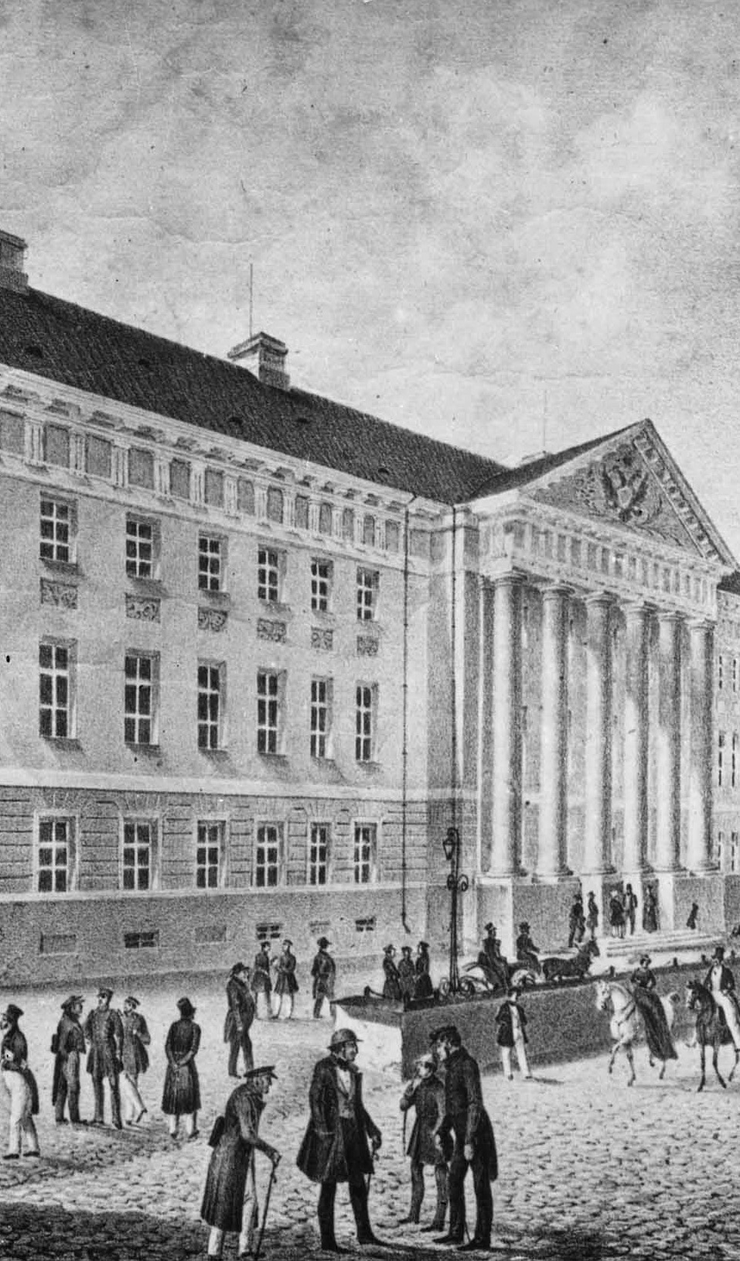
History
Academic excellence since 1632

Slide 4
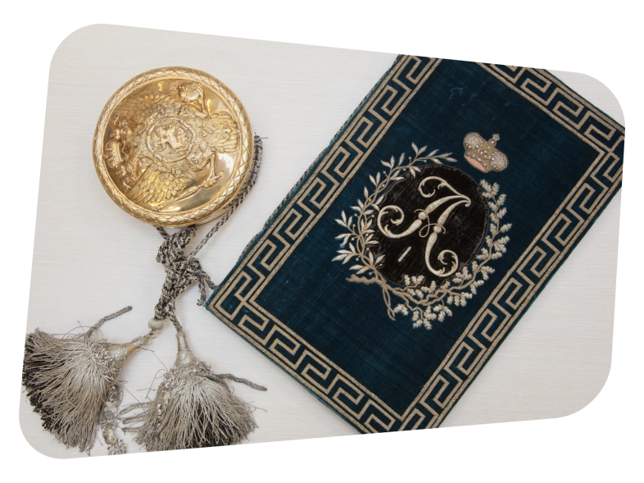
Milestones
1632: founded by Swedish King Gustavus II Adolphus
1802: reopened by Russian Tsar Alexander I as Imperial University at Tartu
1919: reorganized as the University of Tartu of the Republic of Estonia
1944: renamed Tartu State University (under Soviet Union)
1989: reopened as the University of Tartu
2002 Implementation of Bologna Process

Slide 5
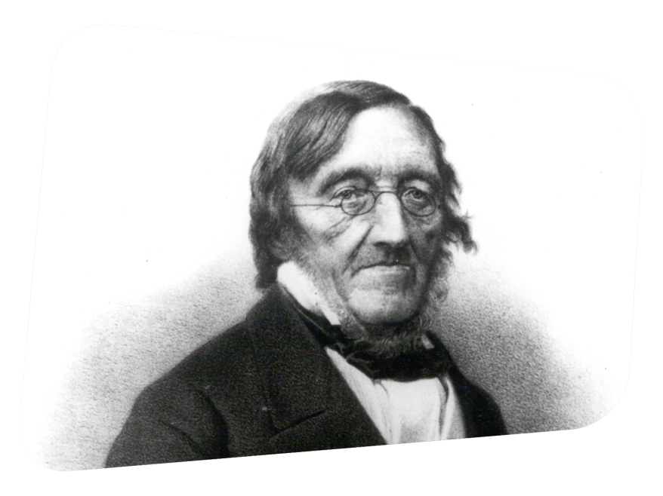
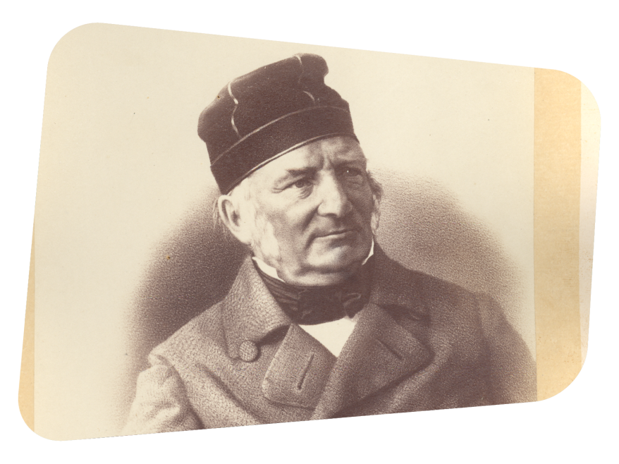
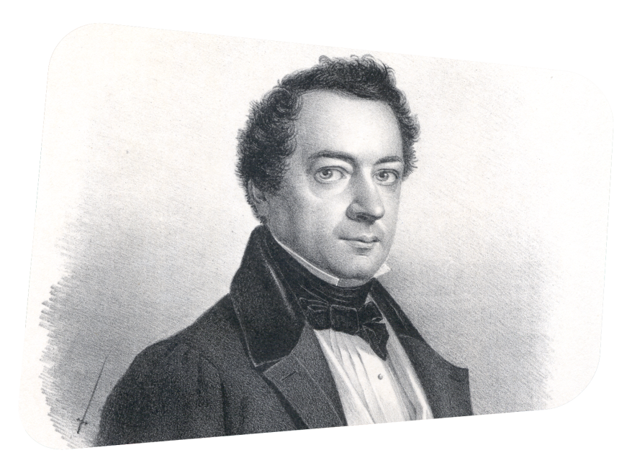
Hall of Fame
Friedrich Struve (Astronomy)
Moritz Hermann von Jacobi (Physics)
Karl Ernst von Baer (Embryology)
Notes:
Friedrich Georg Wilhelm von Struve (1793–1864) – a Baltic-German astronomer from a famous dynasty of astronomers. UT Professor of Astronomy and Director of the Observatory from 1820 until 1839. In 1839, he founded and became the director of the new Pulkovo Observatory near St. Petersburg. Struve carried out micrometric measurements of 2,714 double stars and was the first astronomer to calculate the distance of a star from the Earth (Wega in the Lyre constellation (1836). Struve was also interested in geodetic surveying. He initiated the Struve Geodetic Arc, which was a chain of survey triangulations stretching over 2,820 km across 10 countries from Nordkap in Northern Norway through Tartu to the Black Sea coast. It was added on the UNESCO World Heritage list in 2005.
Karl Ernst von Baer (1792–1876) – a Baltic German biologist. He was one of the founding father of embryology, the discoverer of the mammalian ovum. Baer studied medicine at the University of Tartu in 1810–1814. Baer was the first graduate of Imperial University of Tartu to be elected to the post of a professor abroad – in 1817 he became a professor at Königsberg University (Kaliningrad) and a full professor of zoology in 1821. In Königsberg he studied the embryonic development of animals, discovering the blastula stage of development and the notochord. In 1826 Baer discovered the mammalian ovum and formulated what would later be called the Baer's laws for embryology. He spent the last years of his life (1867–1876) in Tartu, where he became one of the leading critics of the theories of Charles Darwin.
Moritz Hermann Jacoby (1801–1874) – UT Professor of Civil Engineering (1836–1840). Jacoby has earned his place in the history of science as a physicist who constructed the world’s first electromagnetic motor and who during the brief period he taught at the University of Tartu discovered galvanoplastics (1837).

Slide 6
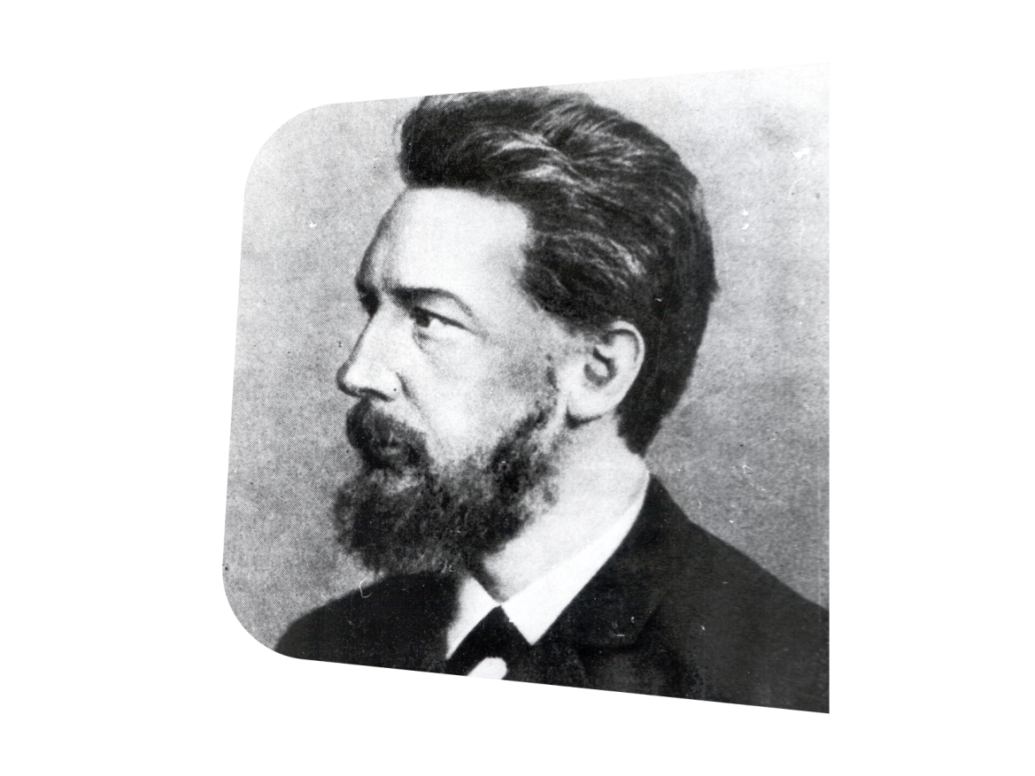
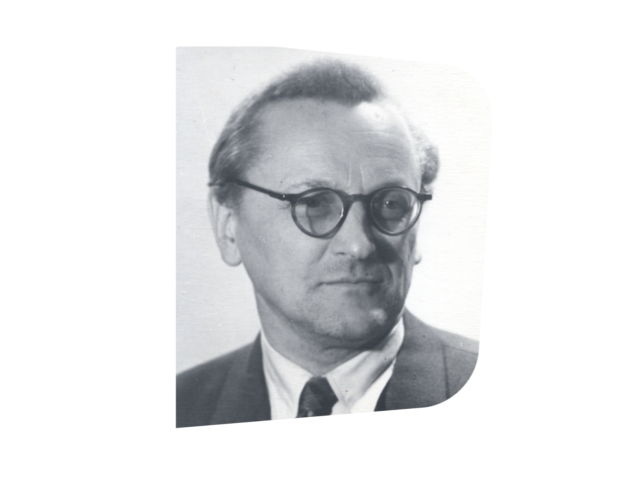
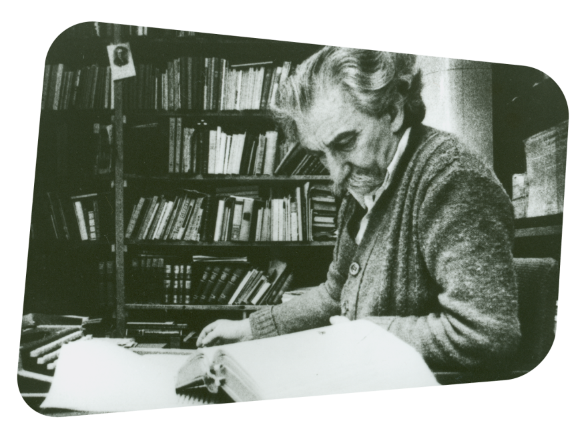
Hall of Fame
Wilhelm Ostwald (Chemistry, Nobel Prize 1909)
Jury Lotman (Semiotics)
Paul Ariste (Finno-Ugristics)
Notes:
Friedrich Wilhelm Ostwald (1853–1932) – a German chemist of Baltic German origin. He received the Nobel Prize in Chemistry in 1909 for his work on catalysis, chemical equilibria and reaction velocities. Ostwald is considered one of the founders of physical chemistry. He studied at Tartu University in 1872–1875 majoring in chemistry. Ostwald defended here his Master’s and Doctoral thesis (in 1878) and he worked in Tartu until 1881, leaving for Riga and later on for Leipzig.
Yuri Lotman (1922–1993) – a Russian-Estonian semiotician, a long-time Professor of Russian Language and Literature at the University of Tartu, formalist critic, and culture historian, founder of the Moscow-Tartu School in the 1960s. Lotman was the founder of structural semiotics in culturology.
Paul Ariste (until 1927 Paul Berg; 1905–1990) – an Estonian linguist renowned for his studies of the Finno-Ugric languages (especially Estonian and Votic), Yiddish and Baltic Romani language. He graduated from the University of Tartu in 1929, and subsequently headed the UT Department of Finno-Ugric Languages (1946–1977). Paul Ariste was the founder of modern Estonian Finno Ugristics. He was also instrumental in reviving Finno-Ugristics in the former Soviet Union, founding the journal Sovetskoye finnougrovedeniye (Советское финноугроведение; Soviet Finno-Ugric Studies, later renamed Linguistica Uralica) and teaching generations of researchers and teachers for all Finno-Ugric peoples in the USSR.

Slide 7
University of Tartu
Today

Slide 8
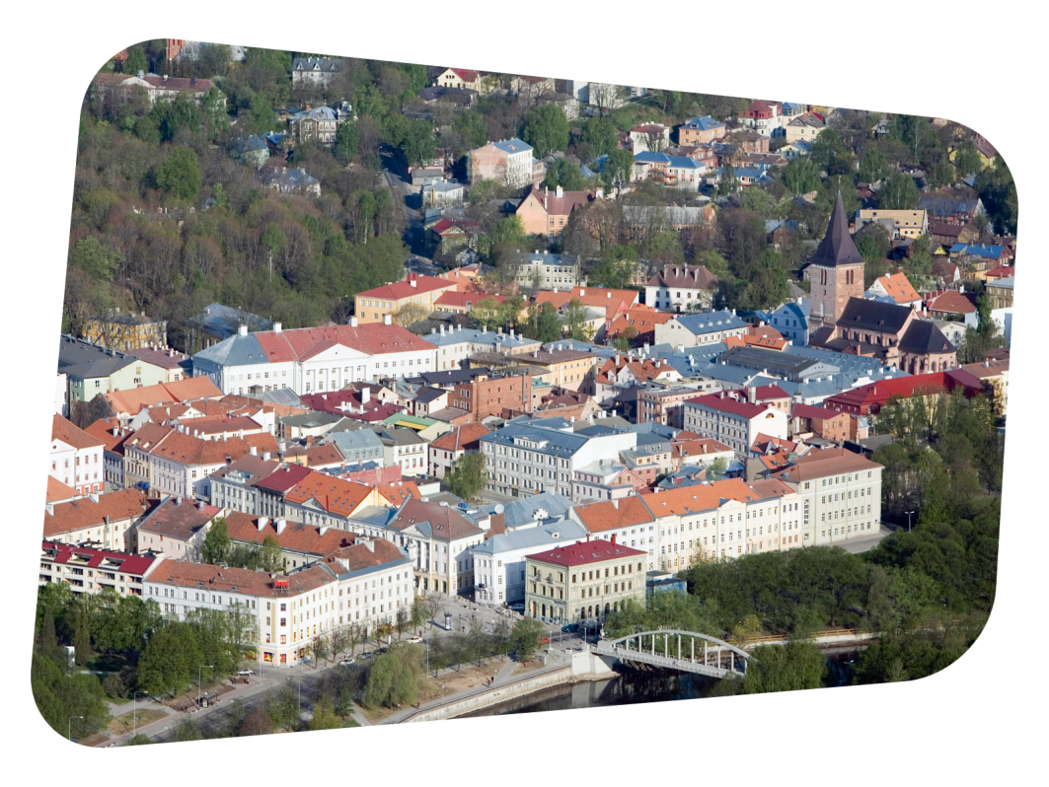
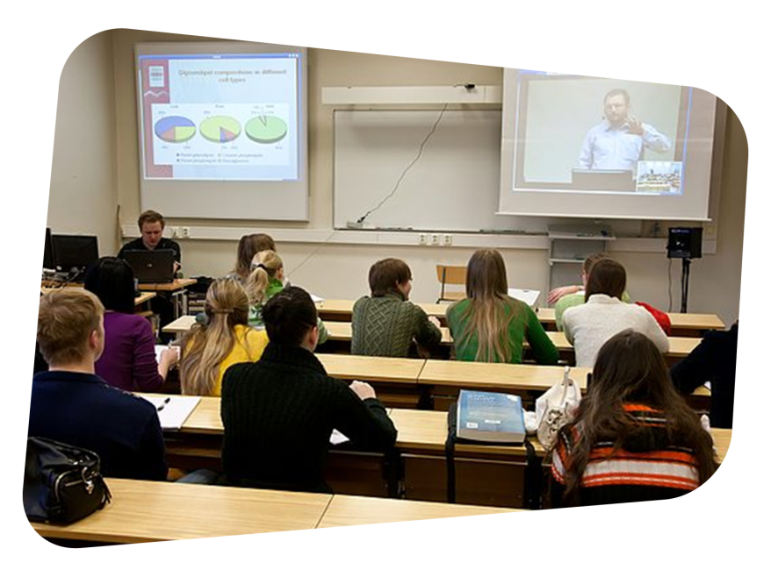
University in a Nutshell
9 Faculties
4 Colleges
Students: 18 000
Staff: 3 800
Professors: 180
Budget: 145.9 MEUR
Research funding: 51.4 MEUR
Notes:
Appr. 600 incoming international students – incl. both degree-seeking and exchange students – from more than 30 countries.
Appr. 100 international faculty.

Slide 9
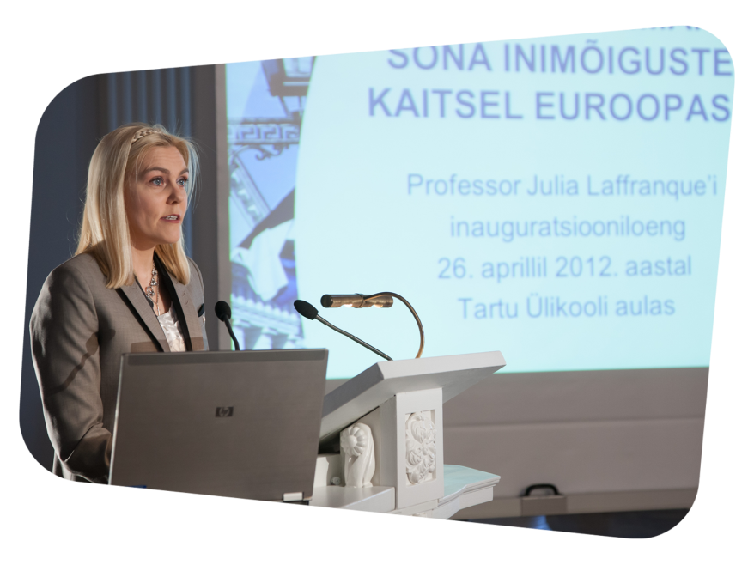
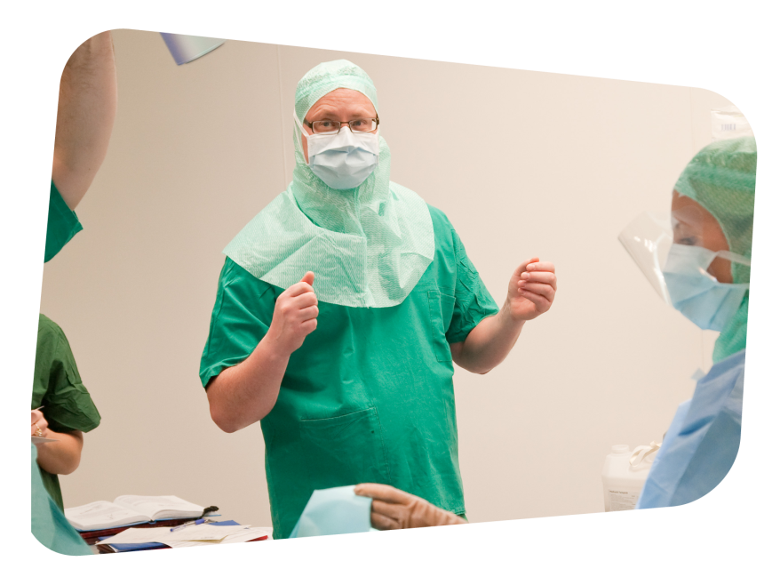
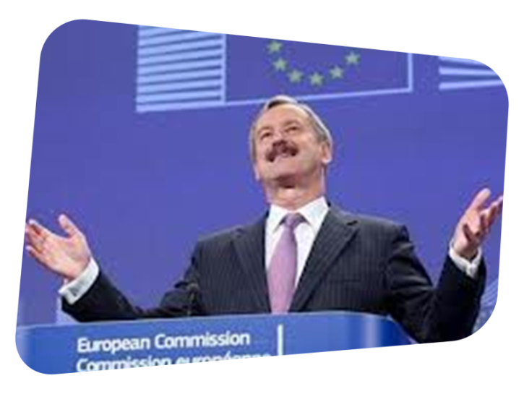
UT Graduates Make Up:
40% of Estonian Parliament
69% of Government Ministers
87% of Attorneys at Law
100% of Judges
95% of Prosecutors
99% of Doctors
Notes:
Euroopa vere ja luuüdi siirdamise ühendus (EBMT) omistas 2013. aastal Tartu ülikooli kliinikumi hematoloogia-onkoloogia kliiniku juhataja professor Hele Everausile silmapaistvate saavutuste eest luuüdi siirdamises EBMT kliinilise elutööauhinna.
Pildil: pildil prof Hele Everaus.
!Pildistatud TÜ ajakirja tellimusel!
Foto Andres Tennus/Tartu Ülikool

Slide 10
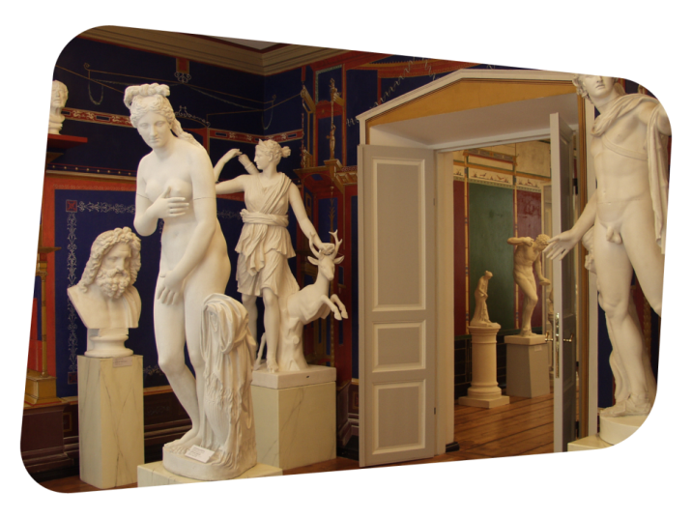
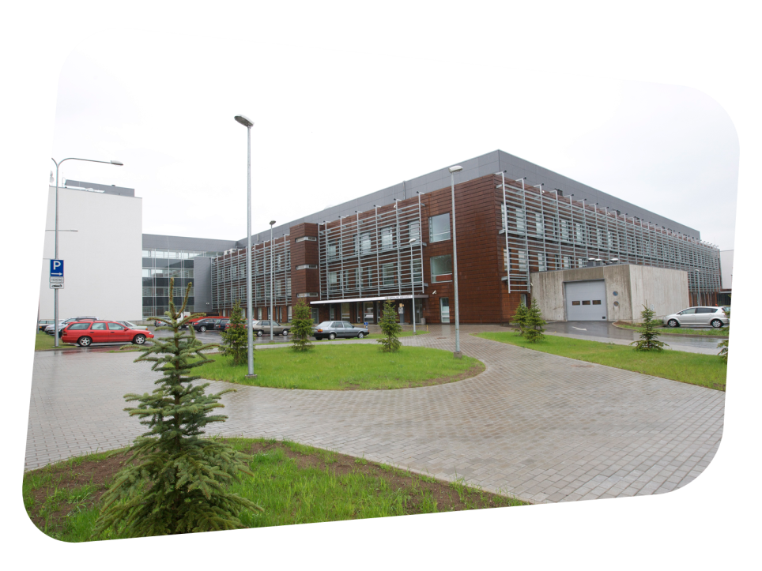
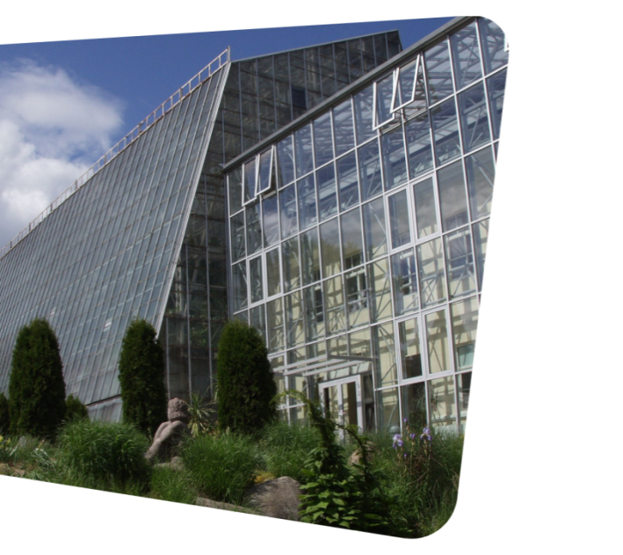
Institutions & Other Units
3 Museums
Botanical Garden
Library: 4.1 mln items
The Gifted and Talented Development Centre
University Clinics

Slide 11
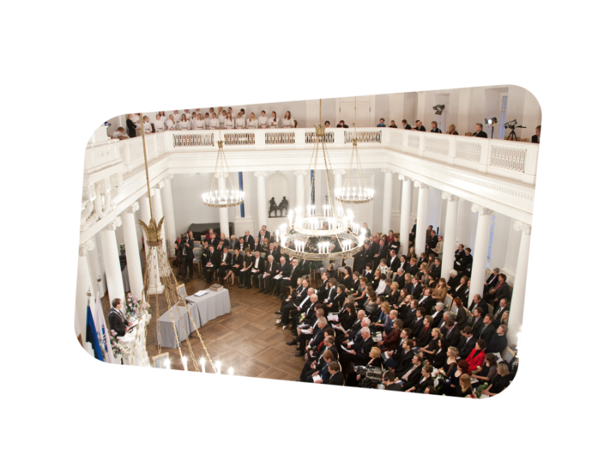
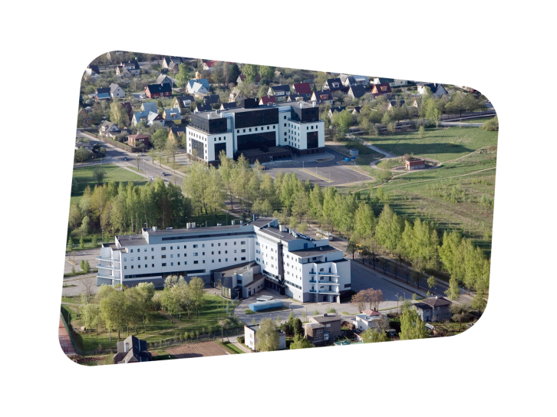
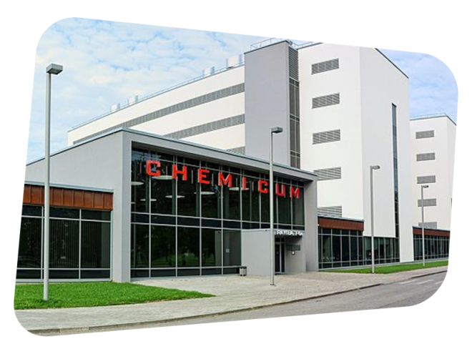
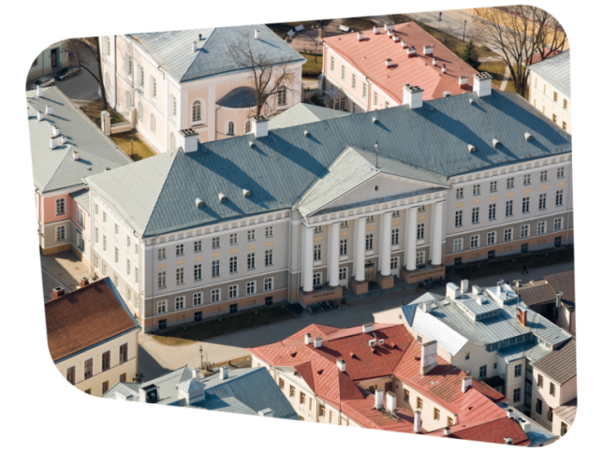
Buildings
UT owns over 100 buildings
Social Sciences and Humanities campus
Science campus: Biomedicum, Chemicum, Institute of Technology, Physicum

Slide 12
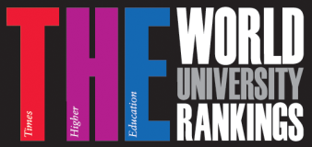
#1 in the Baltics
THE 2012/2013: 351–400
Top 3% of world's best universities
QS World University Rankings
2012/2013: 501–550

Slide 13
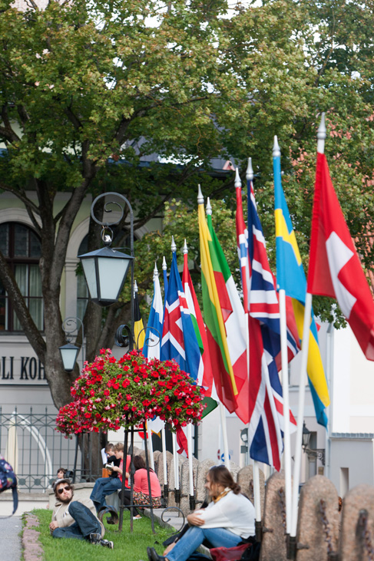
International Relations
Notes:
Pilti vaja

Slide 14
International Networks
Coimbra Group of Universities (since 2003)
Utrecht Network (since 2006)
European University Association (EUA)
Baltic Sea Region University Network (BSRUN)
Founding member 2000

Slide 15
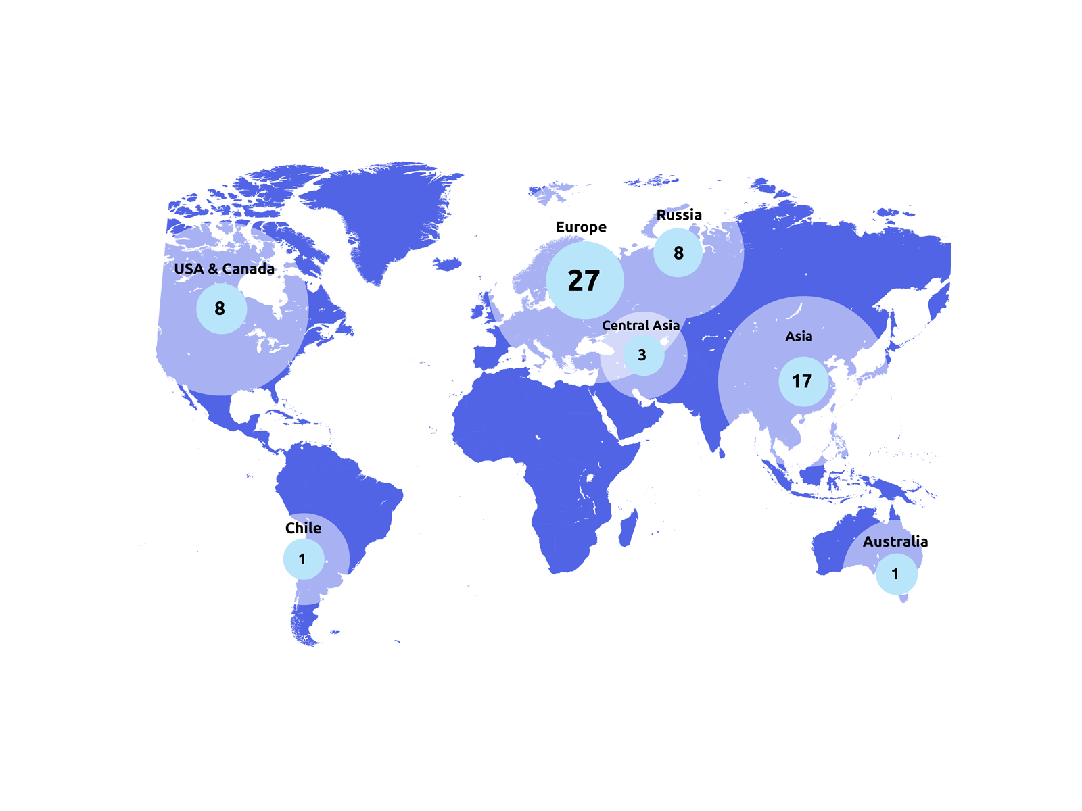
University Partnership Agreements: 65
Notes:
Finland
- University of Helsinki
- Aalto University
- University of Eastern Finland
- University of Jyväskylä
- University of Oulu
- University of Tampere
- University of Turku
France
- University of Pierre and Marie Curie (Paris 6)
- François Rabelais' University of Tours
Georgia
- Tbilisi State University
Germany
- Ernst Moritz Arndt University of Greifswald
- Georg August University Goettingen
- University of Hamburg
- Christian Albrecht University of Kiel
- University of Konstanz
- University of Lübeck
- Westphalian Wilhelms University of Münster
Greece
- University of Athens
Italy
- Università degli Studi di Genova
Latvia
- University of Latvia
Lithuania
- Vilnius University
Moldova
- Moldova State University
The Netherlands
- University of Amsterdam
- University of Groningen
Poland
- Wroclaw University
Portugal
- University of Lisbon
Russia
- Herzen State Pedagogical University of Russia
- Russian State University for Humanities
- Saint Petersburg State University of Economics and Finance
- Saint-Petersburg State University
- Voronezh State University
- Pskov State University
- Lomonosov Moscow State University
- National Research University Higher School of Economics, Moscow
Spain
- University of Granada
Sweden
- University of Gothenburg
- Uppsala University
Australia
University of Melbourne
China
- Hong Kong Baptist University
- Tsinghua University
- Beijing Jiaotong University
- University of Science and Technology Beijing
- Shanghai University
- Southeast University
- Tongji University
- University of Shanghai for Science and Technology
India
Jawaharlal Nehru Unievrsity
Japan
- Kansai Gaidai University
- Waseda University
- Hokkaido University
Kazakhstan
- Kazakh National Pedagogical University Abai
Korea
- Chung-Ang University
- University of Jeonju
- Pusan National University
- Soongsil University
Canada
- University of Toronto
Chile
Mayor University
USA
- University of North Carolina at Greensboro
- West Virginia University
- Michigan Technological University
- Emporia State University
- Nebraska Wesleyan University
- Salisbury University
- George Mason University

Slide 16
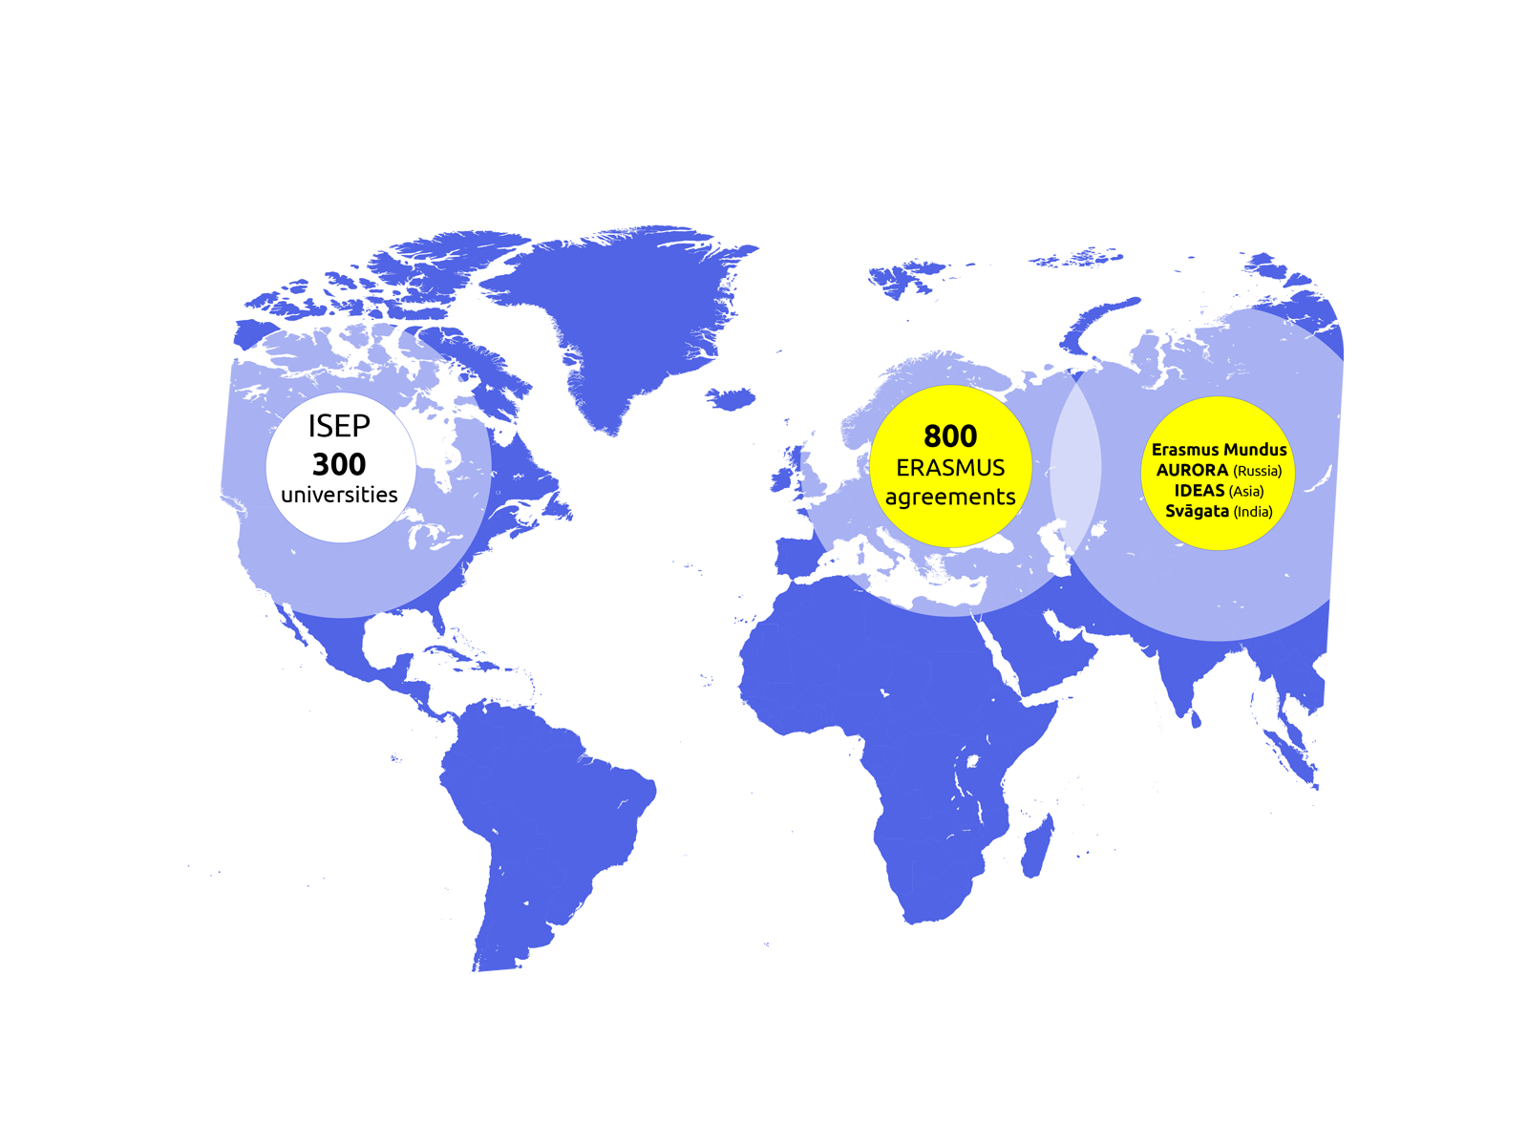
Exchange Programs

Slide 17
Students 2012
1.4% international
4.7% international
6.7% international
International Summer University: about 200

Slide 18
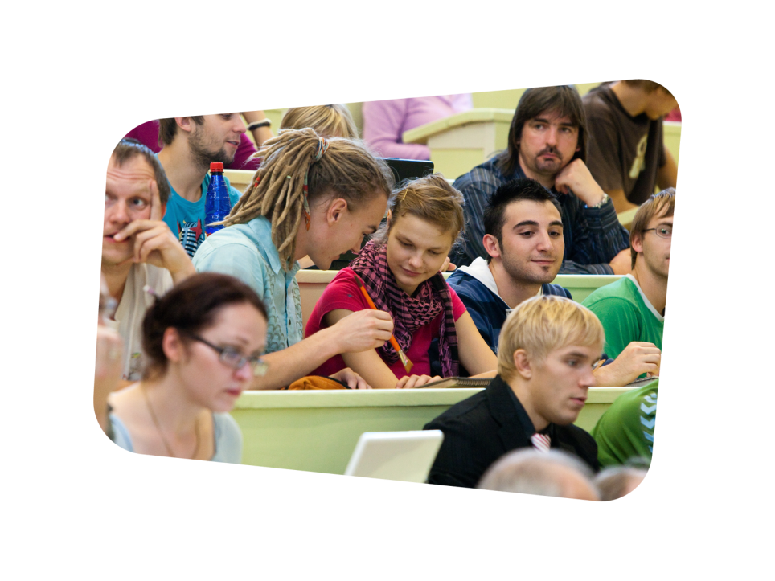
International Degree Programs
Social Sciences
BA Business Administration
MA Baltic Sea Region Studies
EU-Russian Studies
Wellness and Spa Service Design and Management
Sound Engineering Arts (with Tallinn University)
Crossmedia Production
IMESS: Economy, State and Society (Erasmus Mundus)
IMRCEES: International Masters in Russian, Central and East European Studies (Erasmus Mundus)
Humanities
Semiotics
Design and Development of Virtual Environments
Sound Engineering Arts (with Tallinn University)
Natural Sciences
Financial and Actuarial Mathematics
Applied Measurement Science
Materials and Processes of Sustainable Energetics (with Tallinn University of Technology)
Software Engineering (with Tallinn University of Technology)
Cyber Security (with Tallinn University of Technology)
NordSecMob: Security & Mobile Computing (Erasmus Mundus)
Medicine (6 year programme)

Slide 19
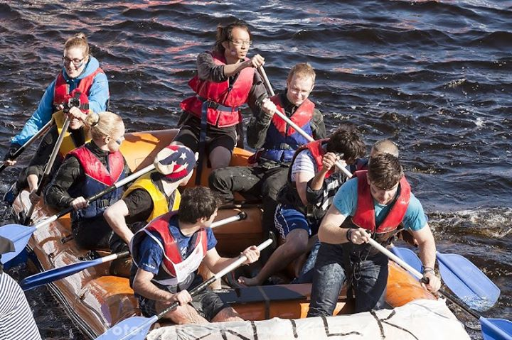
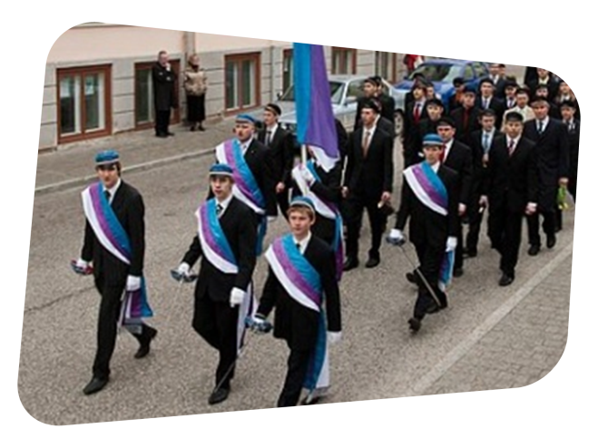
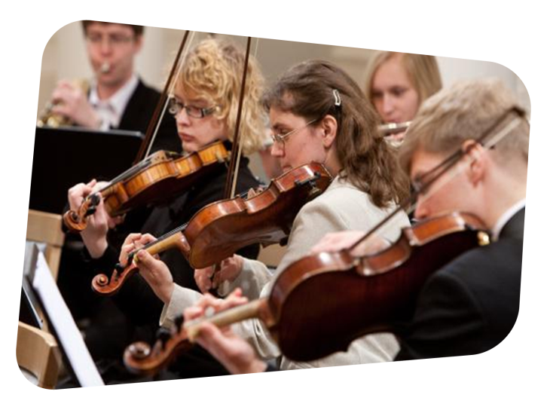
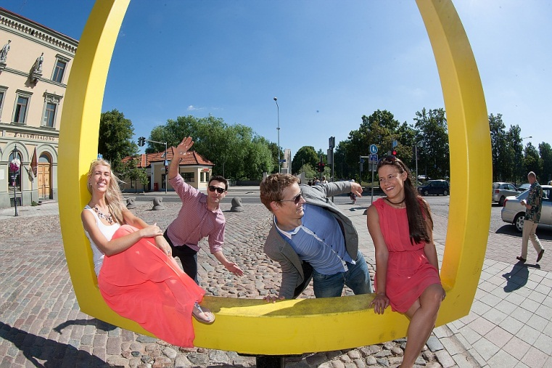
Student Life: 20% of Tartu’s Population
Student organisations
Erasmus Student Network, AIESEC,
AEGEE
Leisure
Autumn & Spring Student Days
UT Academic Sports Club
Choirs, student theatre, symphony orchestra

Slide 20
THANK YOU!
Contact us:
Marketing and Communication Office
Ülikooli 18 Tartu
studyinfo@ut.ee
www.ut.ee/ask

